Slide 1
Gravitational Waves
(& Gravitons ?)
-Vishal Kasliwal

Slide 2
Classical Electromagnetism
Vacuum
Maxwell Field Equations
Light!!
Electromagnetic waves

Slide 3
Quantum Electromagnetism
Hamiltonian of Quantized
Field
Particles
Photons!!
where
is the occupation number of the mode α ie. we have n photons with momentum k.
(Harmonic oscillators !!)
Eigenstates and Energy
Photons are spin one Bosons because they arise from the quantization of a vector field.

Slide 4
General Relativity
Lorentz Transforms
Geodesics
Einstein Field Equation
When no ‘forces’ are acting on a body, it travels along a geodesic!
Fancy Newton’s
1st Law
‘Force’ = Geometry
Lorentz matrices
‘Or how we create gravity!’ – Replaces Newton’s Law of Universal Gravitation
These replace
Galilean Transforms
Set of 10 coupled, non-linear, hyperbolic-elliptical PDEs
Linearize
Weak field, low velocity limit
function of small
perturbation
curved
part
flat
part
small
perturbation

Slide 5
Classical Gravity
Vacuum
Einstein Field Equations
G-Light?
Weak field – low velocity
Linearized
Gravitational waves
Do They Exist?
1993 Noble Prize – Russell Hulse & John Taylor
PSR B1913+16: Binary star with pulsar as one component.
Strong emitter of gravitational radiation.
Orbit decays as predicted by loss of energy due to G-waves in
accordance with GR

Slide 6
Gravitational Waves
Amplitude (h): Fraction of stretching or squeezing.
Frequency (ν): 1/Time between two max squeezes.
Wavelength (λ): Distance along wave between two max squeezes.
Speed (c): Speed of light.
+ polarization
× polarization
Produced by
Binary systems with neutron stars or black holes
Supernova
Detected by
Weber Bar type detectors: 60s, 70s but still investigated – MiniGrail (The Netherlands)
Interferometric type: LIGO (US), CLIO (Japan), GEO 600 (Germany), VIRGO (Europe – Italy), TAMA 300 (Japan)

Slide 7
Gravitons
Quantization of gravitational field (hasn’t been done yet) produces gravitons.
Massless tensor-gauge bosons.
Carry very little energy – might be impossible to detect.
G-wave is wave packet of gravitons just as EM-wave is wave packet of photons.
Polarization of gravitational waves invariant under rotations of 180 degrees.
Spin = 360/(Rotation angle under which polarization modes are invariant) = 360/180 = 2
  Applies to EM waves (S = 360/360 = 1)
Not much known – more research required!

Slide 8
Fin

Slide 9
Planck Units
Length & Time
Energy & Mass
Simplifies forms of equations.

Slide 10
Quantized Hamiltonian of EM Field
Oscillator Hamiltonian
Raising Operator

Slide 11
Metric

Slide 12
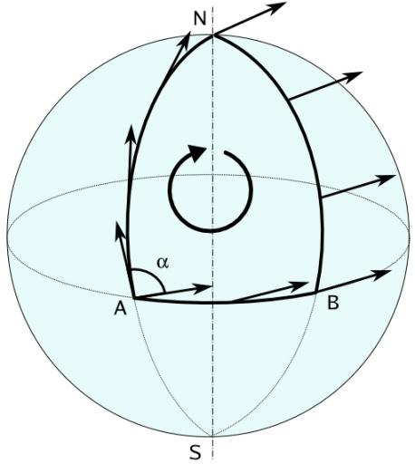
Curvature I
Covariant Derivative
Christoffel Symbol
Reimann Curvature Tensor
Ricci Tensor
Parallel Transport !
Scalar Curvature
Einstein Tensor

Slide 13
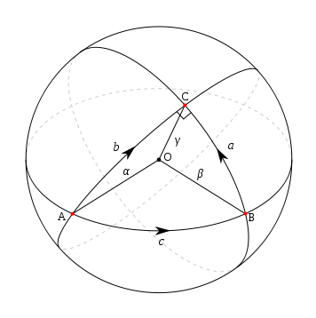
Curvature II
Tensor | Symbol | Indep. Comps
Reimann |  | 20
Ricci |  | 10
Scalar Curvature |  | 1
Einstein |  | 10
Geodesics
Cosmological
Constant
Einstein Tensor
Energy-Momentum Tensor
Typically derived from
action principle or equation of motion
Vacuum energy of
free space.
Measures volume distortions

Slide 14
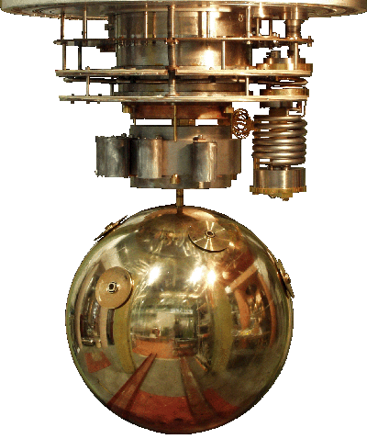
Weber Detector
MiniGrail

Slide 15
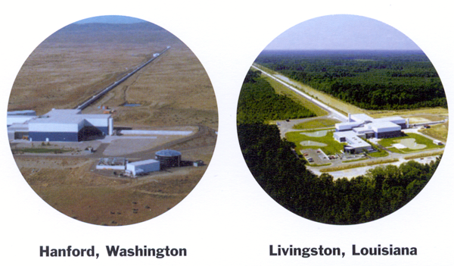
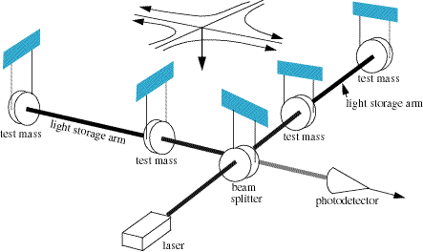
Interferometric Detector

