Slide 1
Deformed Galaxy NGC 3718
Dick Steinberg DVAA Meeting May 20, 2011

Slide 2
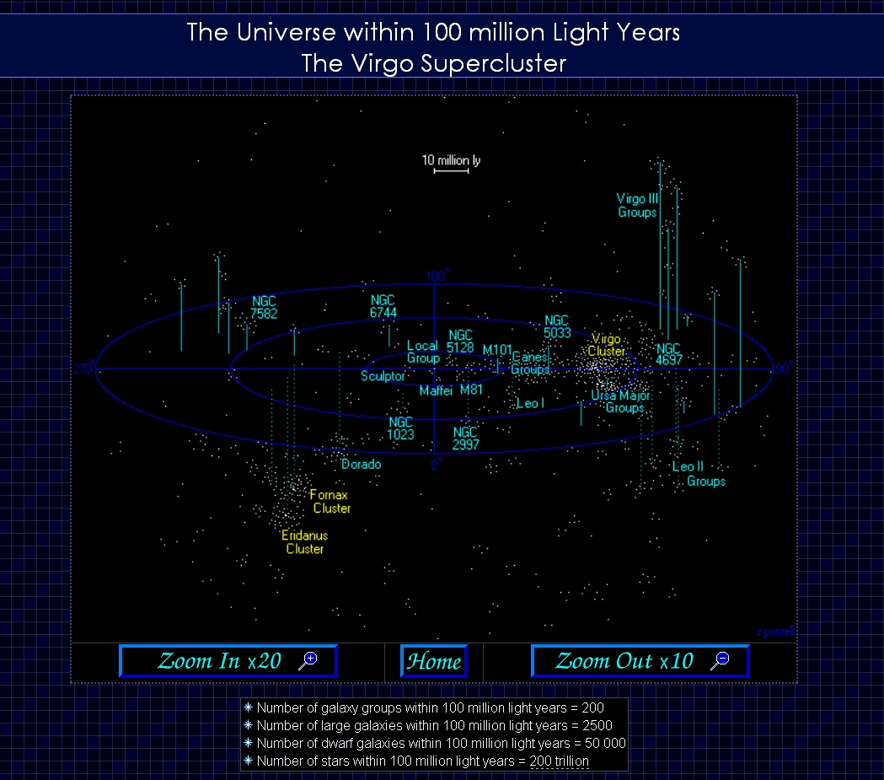

Slide 3
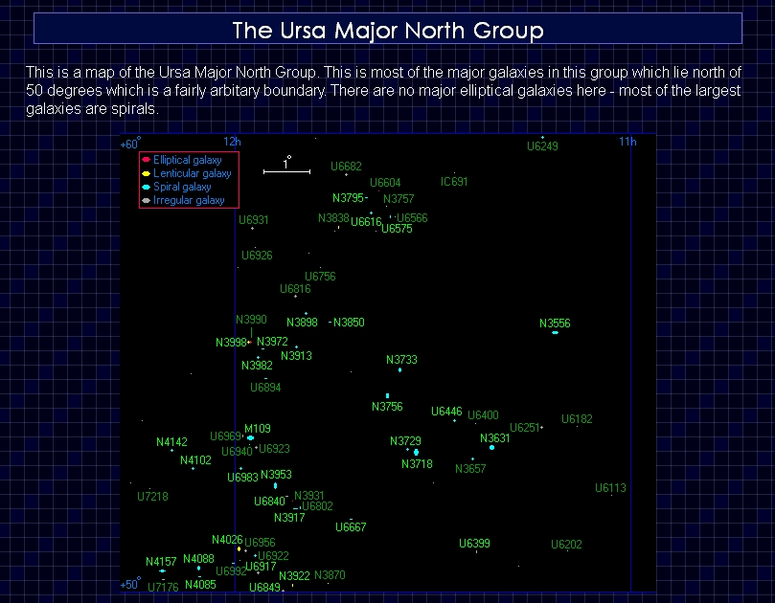

Slide 4
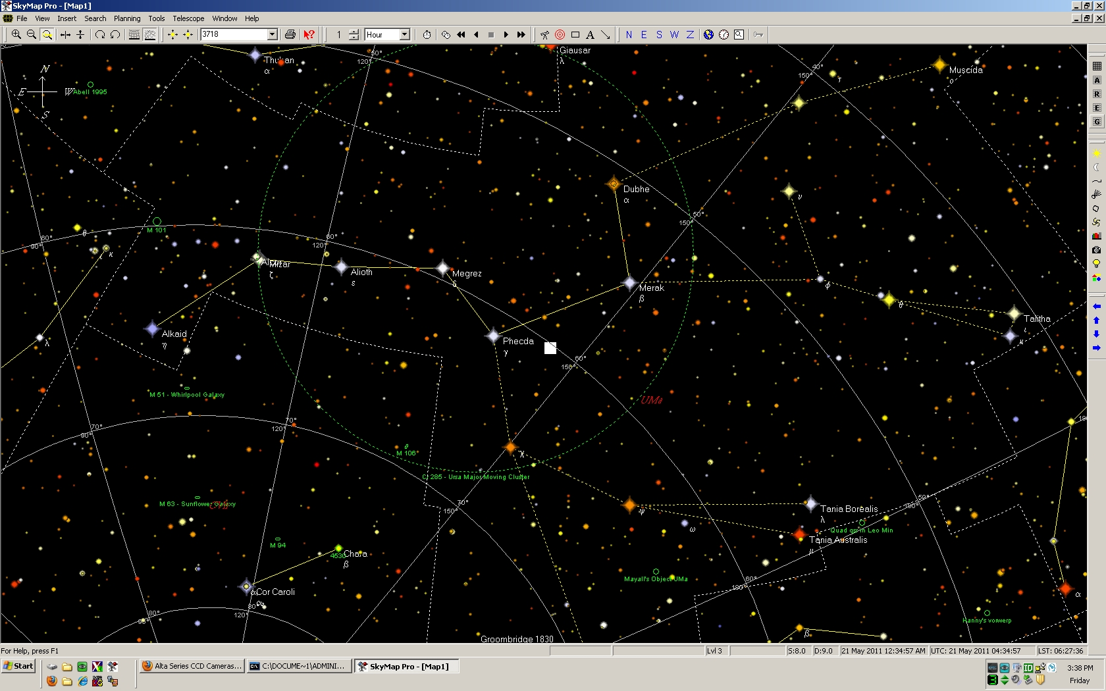
NGC3718 in Galactic Coordinates

Slide 5
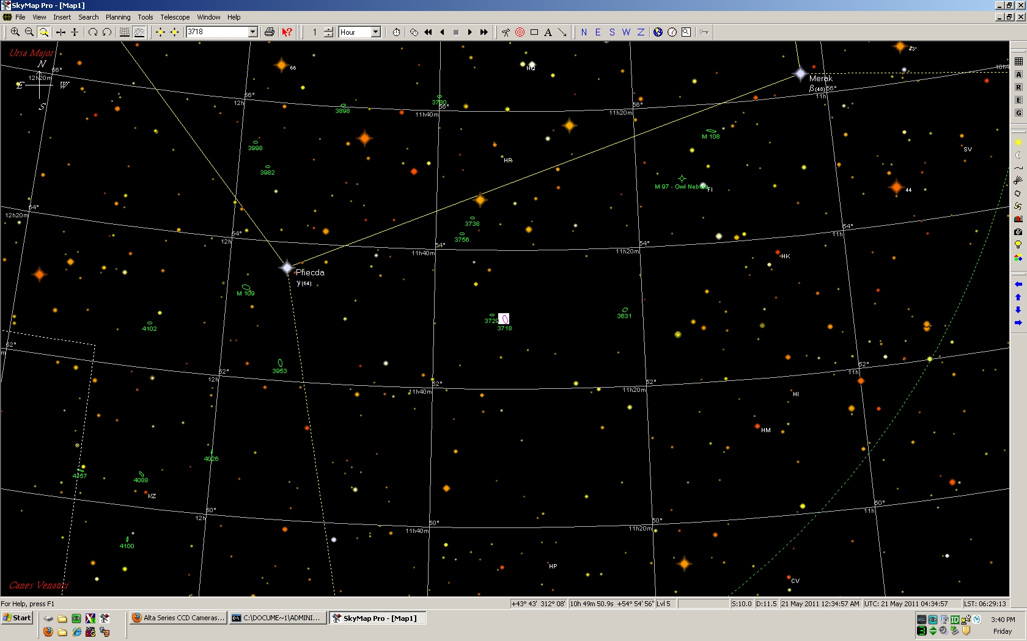
NGC3718 and its Neighbors

Slide 6
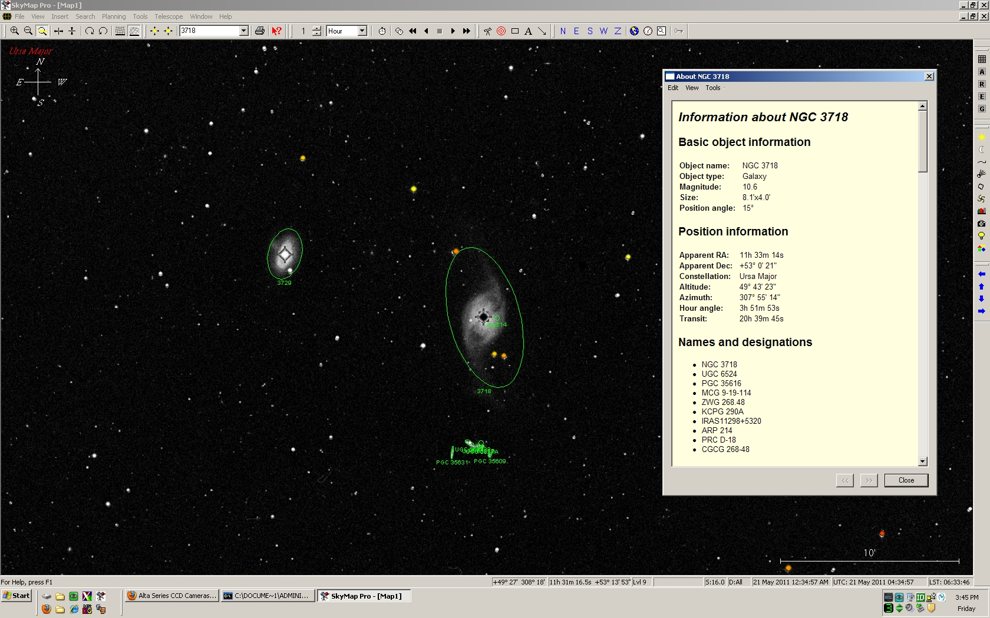
NGC3718

Slide 7
3 scopes, 3 cameras 1 mount on Paramount ME at BMVO, New Ringgold, PA - July 2010

Slide 8
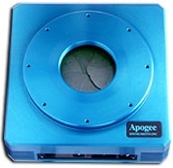
Apogee U16M
Large chip monochrome camera
Kodak KAF-16803 CCD
4096x4096 pixels , each 9 x 9 microns
Chip size 37x37 mm (52mm diagonal)
FOV with 12.5” Hyperion – 50x50 arc min
Plate scale – 0.73 arc sec/pixel

Slide 9
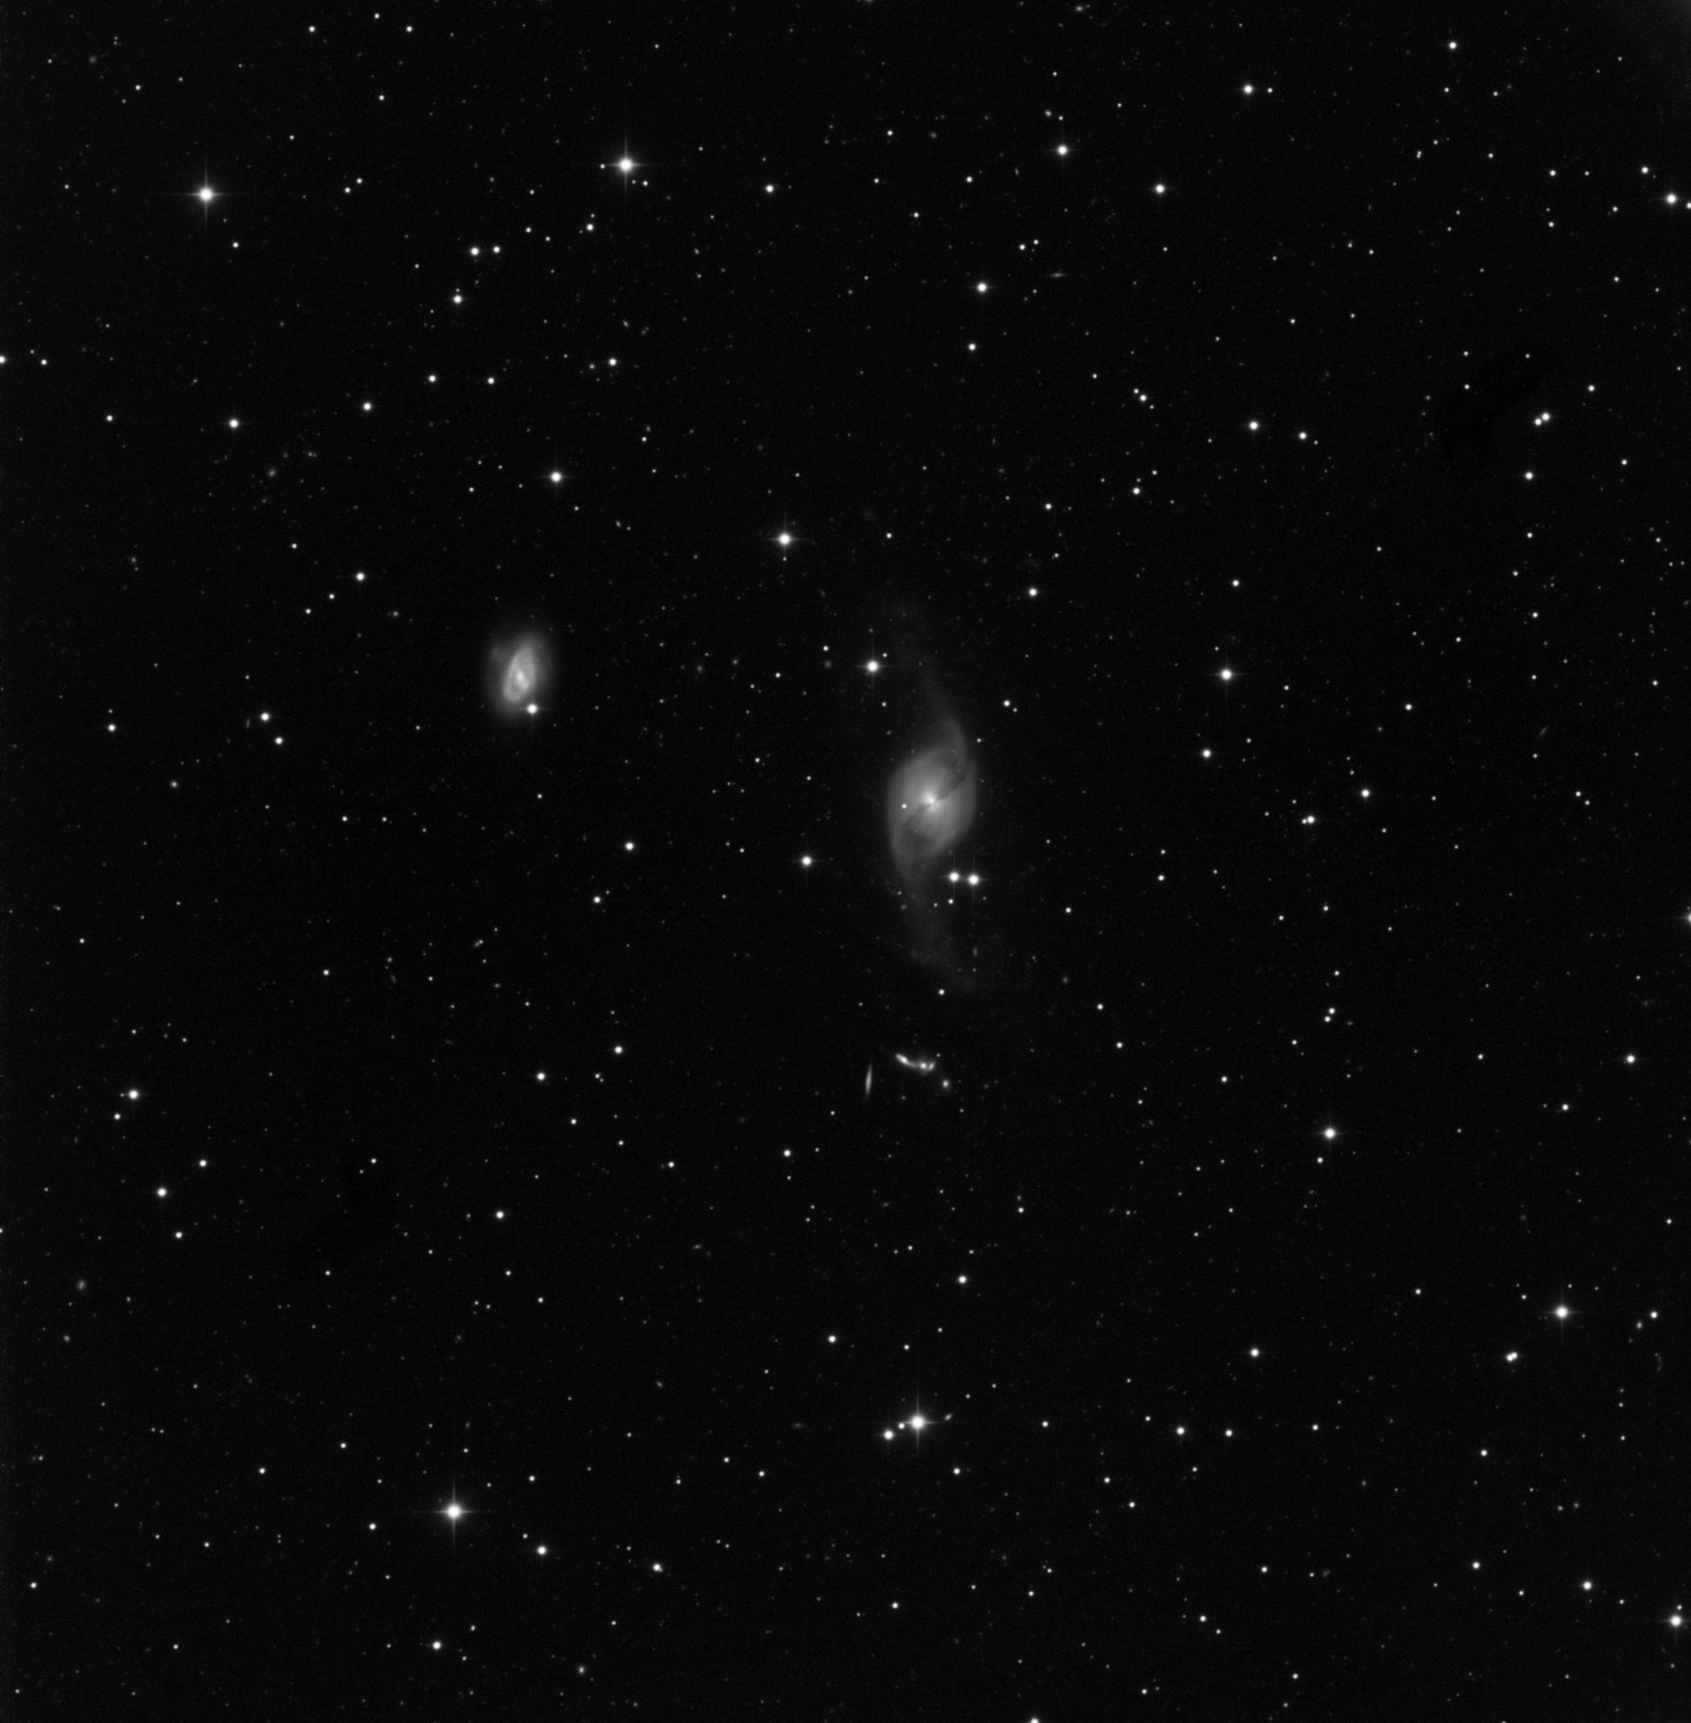
NGC3718 Hyperion + U16M
Notes:
NGC3718 is at 50 Mlt-y
NGC3729 is the smaller ring galaxy

Slide 10
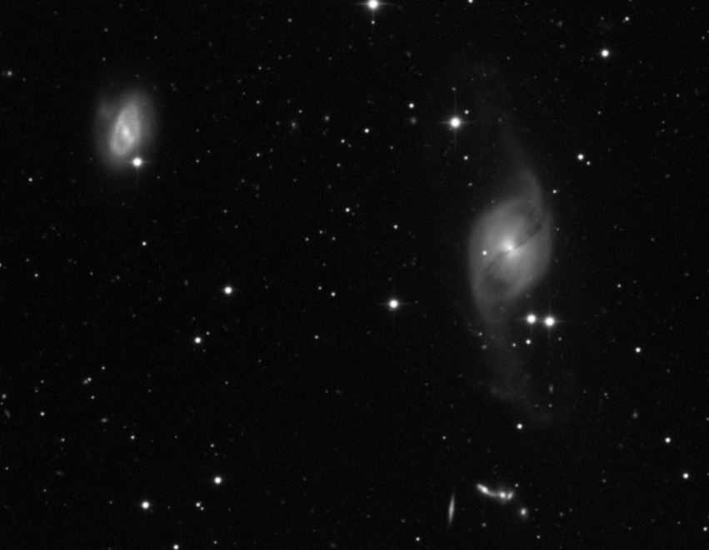
NGC3718 Hyperion + U16M
Notes:
Hickson Group 56 – 5 interacting galaxies at 400 Mlt-y

Slide 11
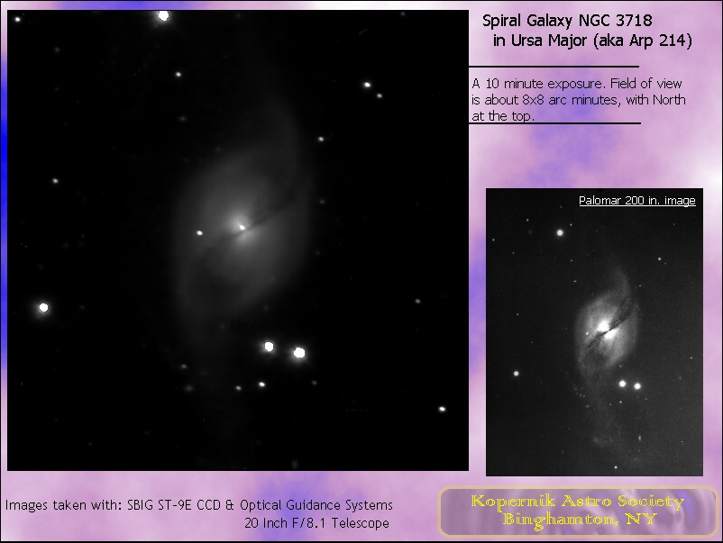
NGC3718 Details

Slide 12
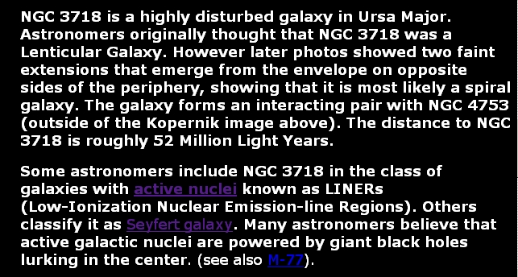

Slide 13
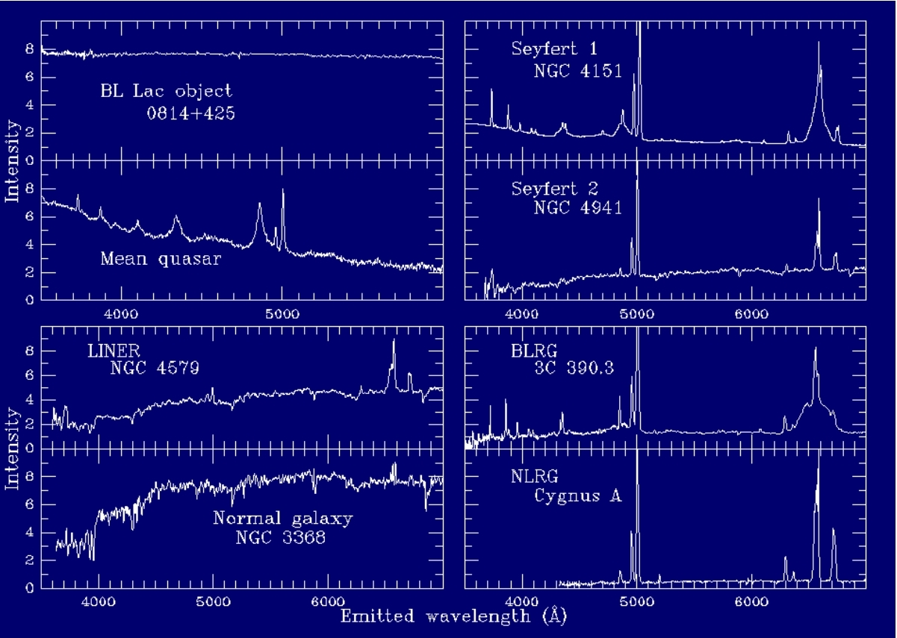
AGN Optical Spectra

