Slide 1
Astro-Imaging at Blue Mountain
Dick Steinberg DVAA Meeting December 17, 2010

Slide 2
Astro-Imaging at Blue Mountain
Site, telescopes and cameras
Wide-field color (106mm Takahashi FSQ + SSPro)
The moon (~1 L s or 4x10⁻¹⁴ Mly)
Milky Way nebulae and clusters (~10⁻³ Mly)
Nearby galaxies (~10 Mly)
Deep monochrome (317mm Hyperion + U16M)
Strongly-lensed galaxy (z=0.38 & 2.73 ➔ 4.3 & 12 Gly)
Quadruply-imaged quasar (z~3 )

Slide 3
Blue Mountain Vista Observatory
On the Colosimo property in New Ringgold PA

Slide 4
Initial Installation at BMVO, Jan 2010
Thanks to Don D’Egidio and Frank Colosimo

Slide 5
Initial Installation at BMVO, Jan 2010
Don and Dick

Slide 6
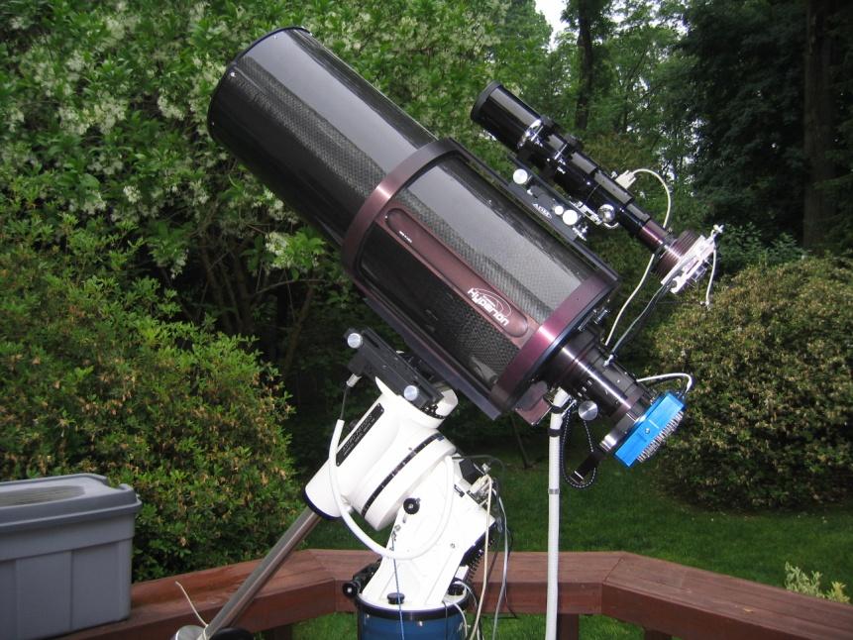
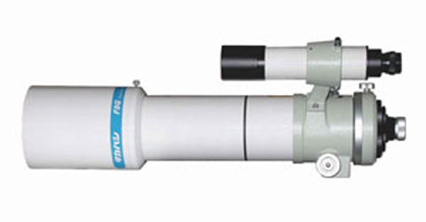
The Telescopes
Takahashi FSQ-106N
quadruplet fluorite APO
refractor 106mm f/5
Starizona Hyperion corrected Cassegrain reflector 317mm f/8
70 mm image circle

Slide 7
Hyperion 12.5” f/8 Corrected Cassegrain on AP1200 mount in Narberth PA, May 2010

Slide 8
3 scopes, 3 cameras 1 mount on Paramount ME at BMVO, New Ringgold, PA - July 2010

Slide 9
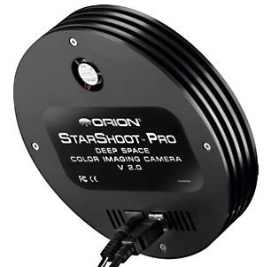
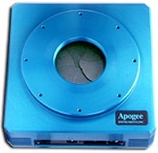
The Cameras
Color – Orion StarShoot Pro v1
(used with NP101 and TAK FSQ106)
Monochrome – Apogee U16M
(used with 12.5” Hyperion)

Slide 10
Orion StarShoot Pro v1
One-shot color camera, Bayer filter matrix
3032x2016 pixels (total 6.1 MP), each 7.8 x 7.8 microns
Chip size 25.1x17.6 mm
Unregulated thermoelectric cooling
FOV w FSQ106 – 2.5 x 1.7 degrees
Plate scale – 3.01 arc sec/pixel
Used for wide-field color images
Limiting magnitude ~16

Slide 11
Apogee U16M
Large chip monochrome camera
Kodak KAF-16801E full frame CCD
4096x4096 pixels (16MP total), each 9 x 9 microns
Chip size 37x37 mm (52mm diagonal)
FOV with 12.5” Hyperion – 50x50 arc min
Plate scale – 0.73 arc sec/pixel
Microlenses and anti-blooming gates
Peak QE (550nm) 69%
Thermoelectric cooling (max 45 C below ambient)
Limiting magnitude ~21 (w 12.5” Hyperion at BMVO)

Slide 12
Two-day old Moon

Slide 13
M8, the Lagoon Nebula in Sagittarius

Slide 14
M20, the Trifid Nebula in Sagittarius
Notes:
30x2min, cropped

Slide 15
The California Nebula in Perseus, NGC1499

Slide 16
The Pleiades, M45

Slide 17
M42, the Orion Nebula

Slide 18
Barnard 33, the Horsehead Nebula in Orion (part of IC434)

Slide 19
The Rosette Nebula in Monoceros NGC 2237

Slide 20
M31, the Andromeda Galaxy

Slide 21
M57, the Whirlpool Galaxy

Slide 22
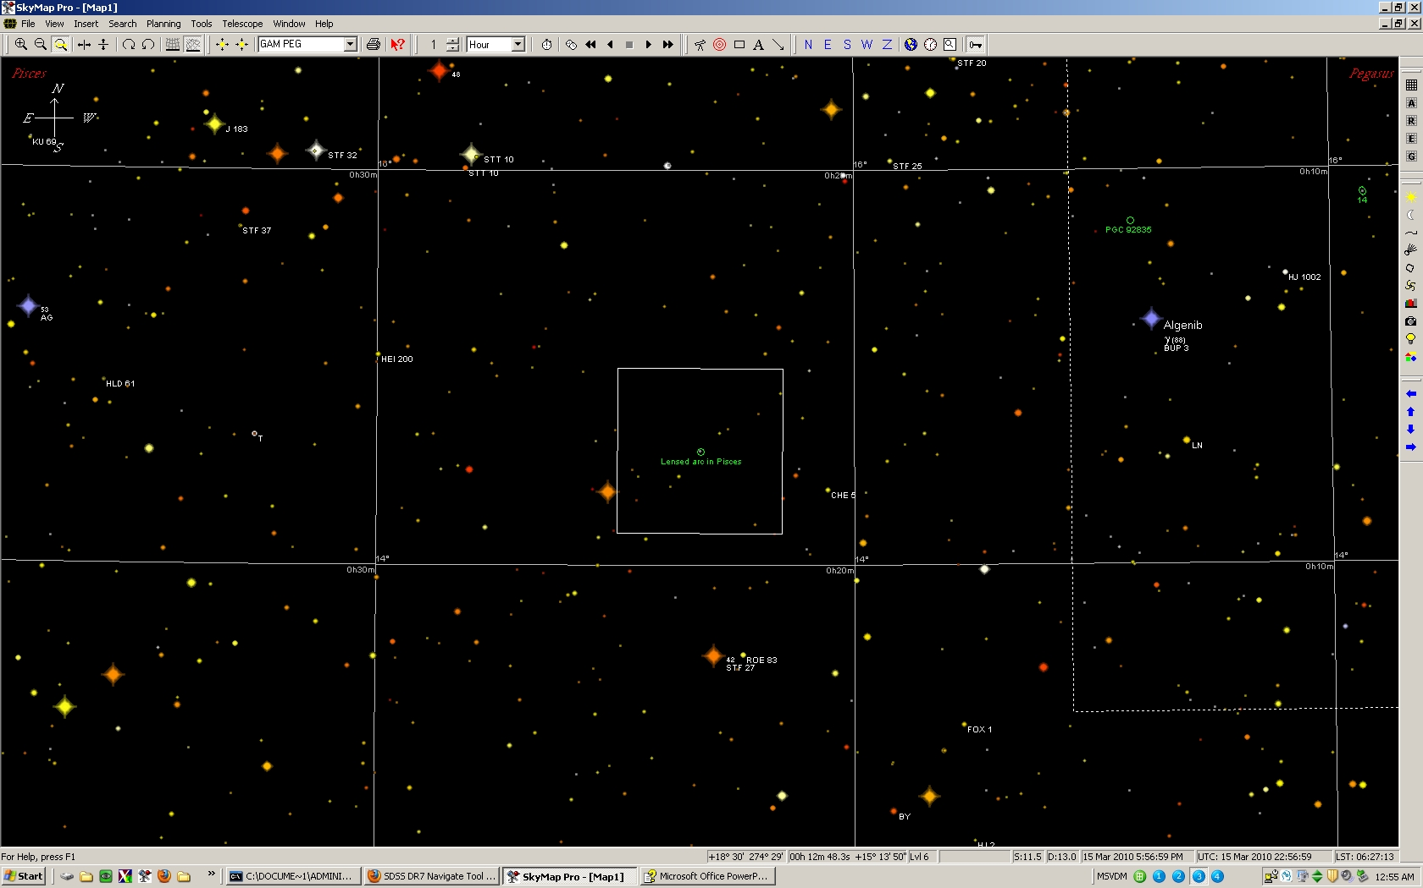
Lyman Break Galaxy (LBG) in Pisces

Slide 23
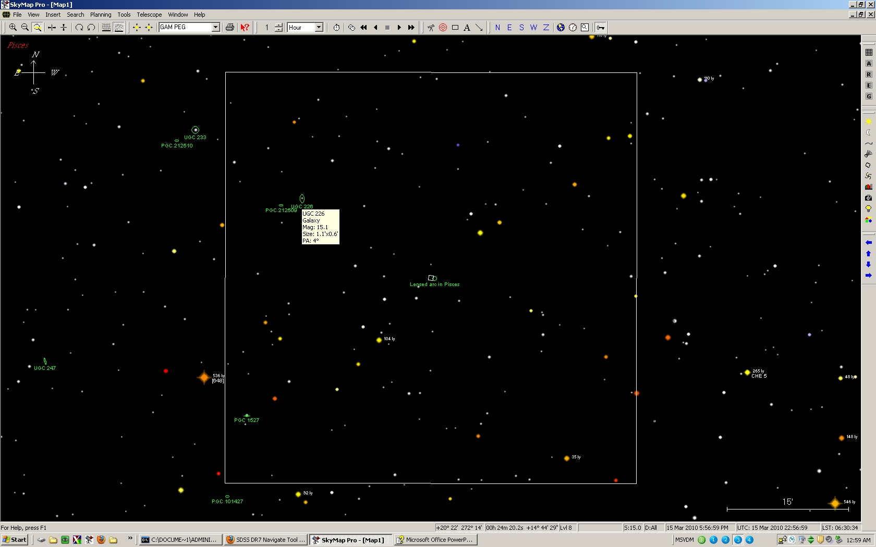
Lyman Break Galaxy (LBG) in Pisces

Slide 24
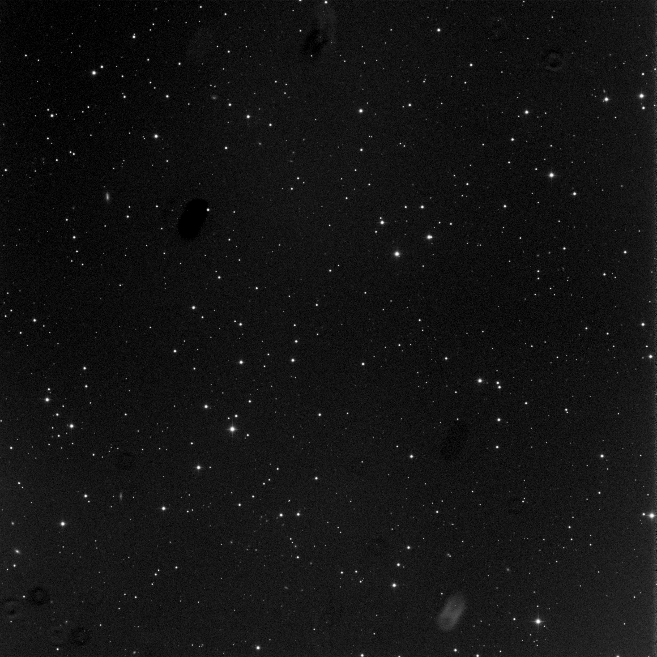
Lyman Break Galaxy (LBG) in Pisces
50 x 50 arc min near Algenib
(SE corner of the great square of Pegasus)
Notes:
50 x 50 arc min near Algenib
(SE corner of the great square of Pegasus)

Slide 25
Lyman Break Galaxy (LBG) in Pisces

Slide 26
Lyman Break Galaxy (LBG) in Pisces
Spectrum w 2.5m SDSS telescope
Notes:
Spectrum w 2.5m SDSS telescope

Slide 27
Calculation of the redshift (z)
Observed H_{α}: λ = 9060 Å
H_{α} rest wavelength: λ = 6562 Å
z = (9060/6562) - 1 = 0.380

Slide 28
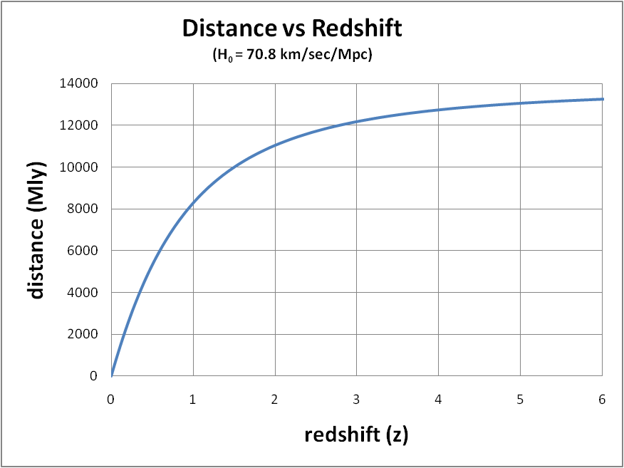
(distance = c * look-back time )
Notes:
distance = look back time * speed of light

Slide 29
Lyman Break Galaxy (LBG) in Pisces
Arc is distorted image of a Lyman Break Galaxy (LBG) at z = 2.73 (d ~ 12 Gly) - a star-forming galaxy at ~20% of Hubble time; intrinsically very luminous (~6 x L*)
The LBG is rendered visible (mag~21) by its luminosity and by strong lensing by foreground Luminous Red Galaxy (LRG) (mag~19) SDSS J002240.91+143110.4 at z = 0.38 (dist ~ 4.3 Gly)

Slide 30
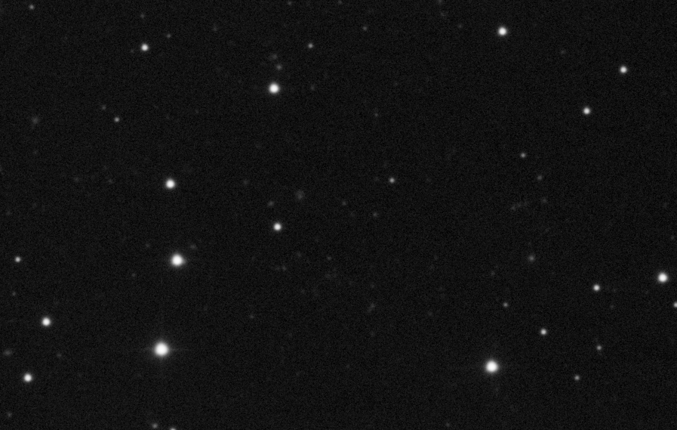
Lyman Break Galaxy (LBG) in Pisces
Exposure = 31 x 5 min
Notes:
Exposure = 31 x 5 min

Slide 31
Lyman Break Galaxy (LBG) in Pisces

Slide 32
Lyman Break Galaxy (LBG) in Pisces

Slide 33
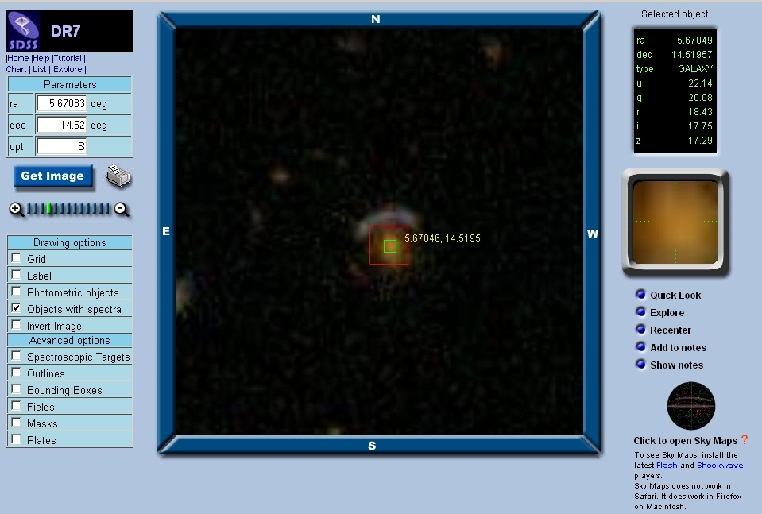
Lyman Break Galaxy (LBG) in Pisces

