Slide 1
Quadruple Quasar in Leo Minor

Slide 2
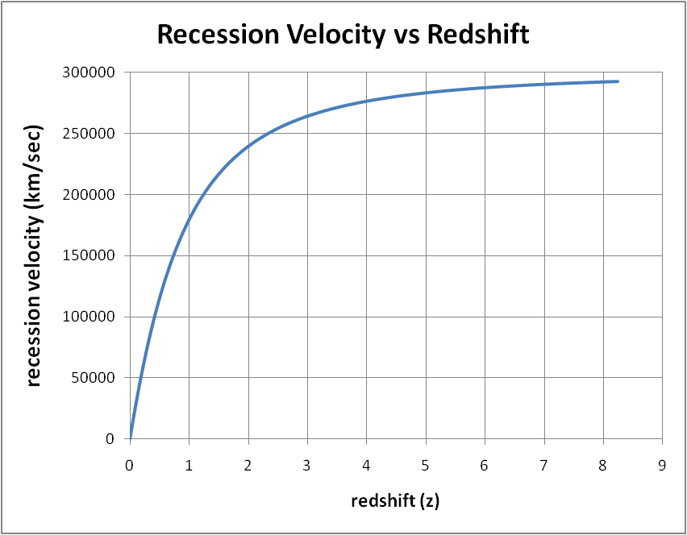

Slide 3
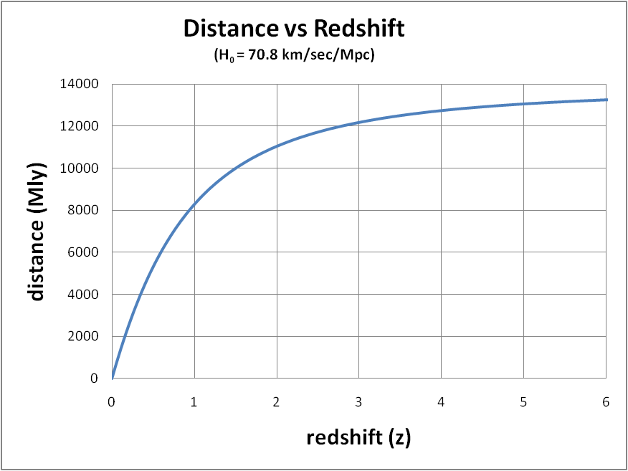
(distance = c * look-back time )
Notes:
distance = look back time * speed of light

Slide 4
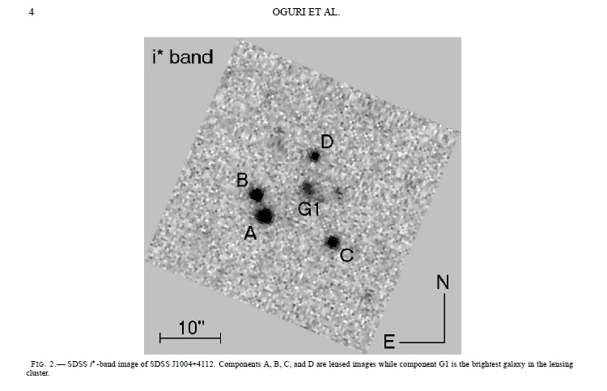
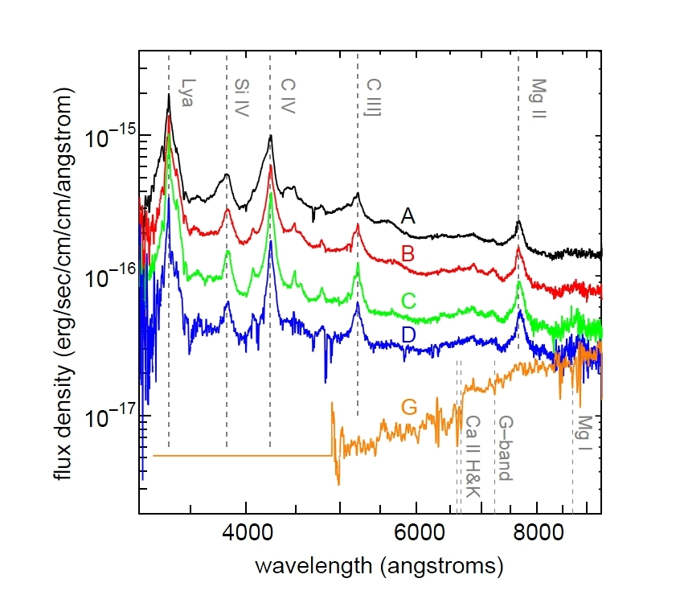
SDSS J1004+4112, a Quadruply-Imaged QSO
  Discovered in 2003 (SDSS) by Inada et al. (including Gordon Richards)
  Spectroscopy at Keck I measures z=1.73
  Lensed by galaxy cluster at z=0.68
  Note that A is about 1 magnitude brighter than C
Notes:
SDSS J1004+4112, a Lensed QSO w Quadruple Images
Discovered in 2003 (SDSS) by Inada et al.
(including Gordon Richards)
Spectroscopy at Keck I ➔ z=1.73
Lensed by galaxy cluster at z=0.68

Slide 5
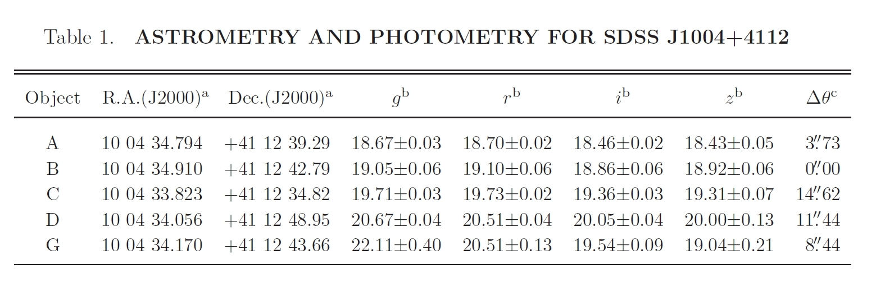

Slide 6
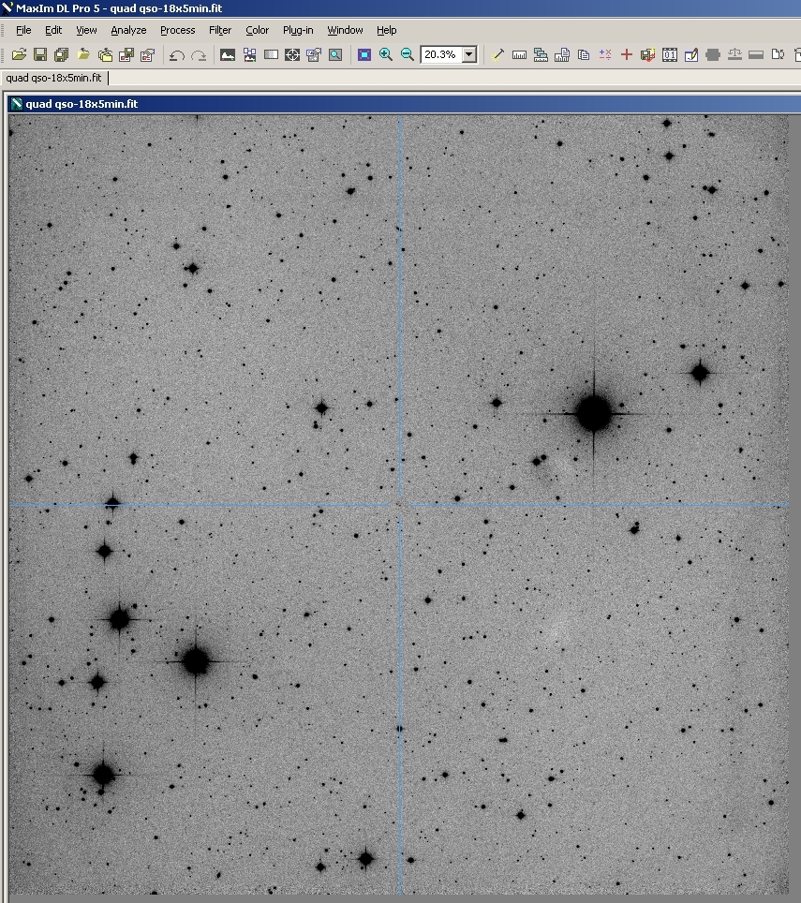
90-minute Hyperion image centered on
the quadruple quasar
(50 x 50 arcmin)
The brightest star is
TW LMi, mag ~7.4
Notes:
Hyperion image of the 50’x50’ field
centered on the quadruple quasar

Slide 7
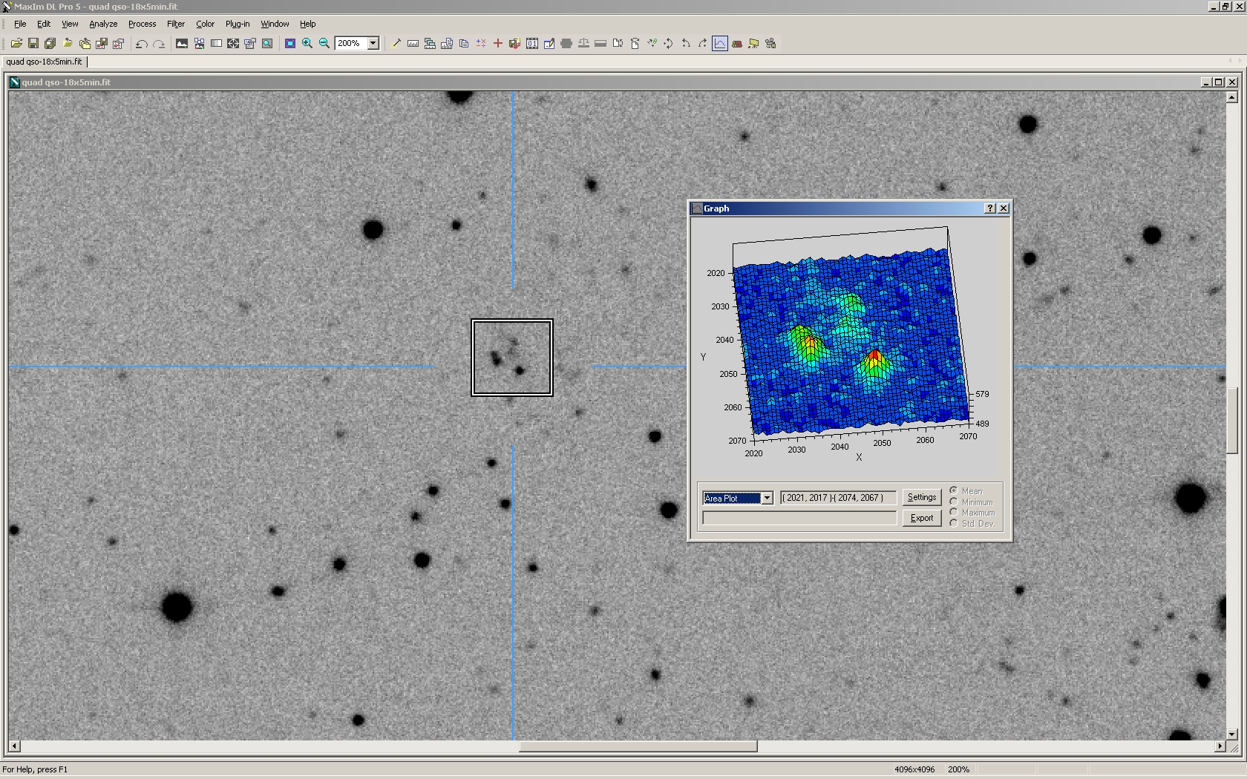
Hyperion image detail
C is now brighter than A!
Notes:
C is now brighter than A!

