Slide 1
Remote Imaging at Blue Mountain
Dick Steinberg DVAA Meeting January 4, 2013

Slide 2
Astro-Imaging at Blue Mountain
Site, telescopes and cameras
Wide-field color (106mm Takahashi FSQ + SSPro)
The moon (~1 L s or 4x10⁻¹⁴ Mly)
Milky Way nebulae and clusters (~10⁻³ Mly)
Nearby galaxies (~10 Mly)
Deep monochrome (317mm Hyperion + U16M)
Strongly-lensed galaxy (z=0.38 & 2.73 ➔ 4.3 & 12 Gly)
Quadruply-imaged quasar (z~3 )

Slide 3
Blue Mountain Vista Observatory
On the Colosimo property in New Ringgold PA

Slide 4
Initial Installation at BMVO, Jan 2010
Thanks to Don D’Egidio and Frank Colosimo

Slide 5
Initial Installation at BMVO, Jan 2010
Don and Dick

Slide 6
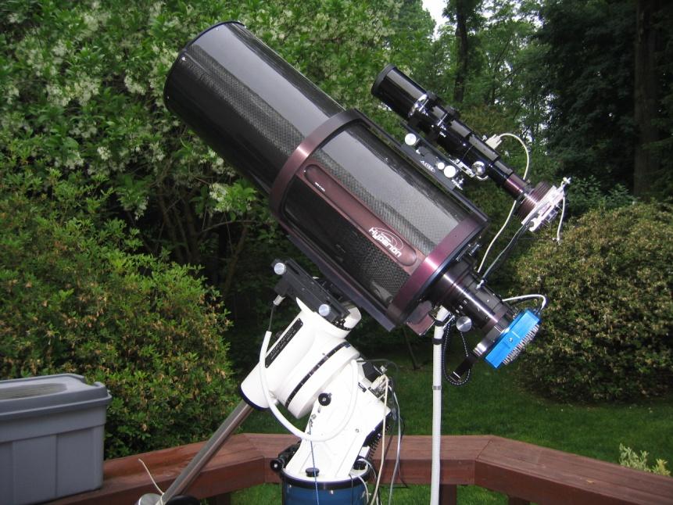
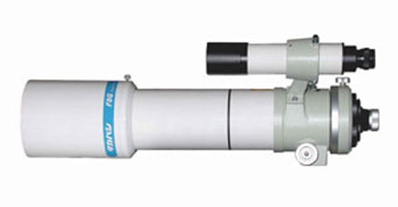
The Telescopes
Takahashi FSQ-106N
quadruplet fluorite APO
refractor 106mm f/5
Starizona Hyperion corrected Cassegrain reflector 317mm f/8
70 mm image circle

Slide 7
3 scopes, 3 cameras 1 mount on Paramount ME at BMVO, New Ringgold, PA - July 2010

Slide 8
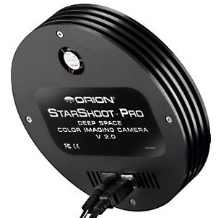
The Camera
Orion StarShoot Pro v1- One-shot Color

Slide 9
Orion StarShoot Pro v1
One-shot color camera, Bayer filter matrix
3032x2016 pixels (total 6.1 MP), each 7.8 x 7.8 microns
Chip size 25.1x17.6 mm
Unregulated thermoelectric cooling
FOV w FSQ106 – 2.5 x 1.7 degrees
Plate scale – 3.01 arc sec/pixel
Used for wide-field color images
Limiting magnitude ~16

Slide 10
Two-day old Moon

Slide 11
M8, the Lagoon Nebula in Sagittarius

Slide 12
M20, the Trifid Nebula in Sagittarius
Notes:
30x2min, cropped

Slide 13
The California Nebula in Perseus, NGC1499

Slide 14
The Pleiades, M45

Slide 15
M42, the Orion Nebula

Slide 16
Barnard 33, the Horsehead Nebula in Orion (part of IC434)

Slide 17
The Rosette Nebula in Monoceros NGC 2237

Slide 18
M31, the Andromeda Galaxy

