Slide 1
Astro-Imaging Highlights from BMVO-2
Dick Steinberg
DVAA Meeting
December 17, 2010
    Site, telescopes and cameras
    Milky Way nebulae and clusters (~10⁻³ Mly)
    Nearby galaxies (~10 Mly)
    Lyman-Break galaxy (z = 2.73 ⇨ 12 Gly)
    Quadruple Quasar
Notes:
➔

Slide 2
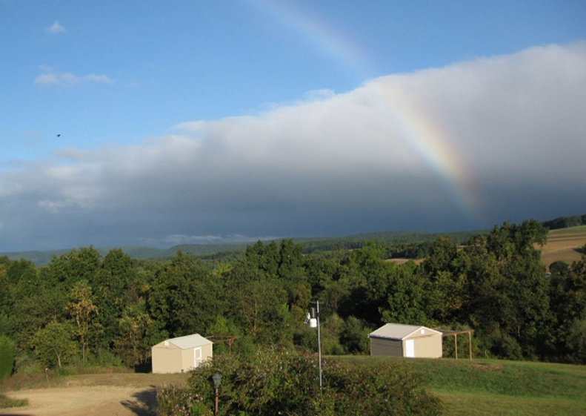
Blue Mountain Vista Observatory
On the Colosimo property in New Ringgold PA
Notes:
⬇

Slide 3
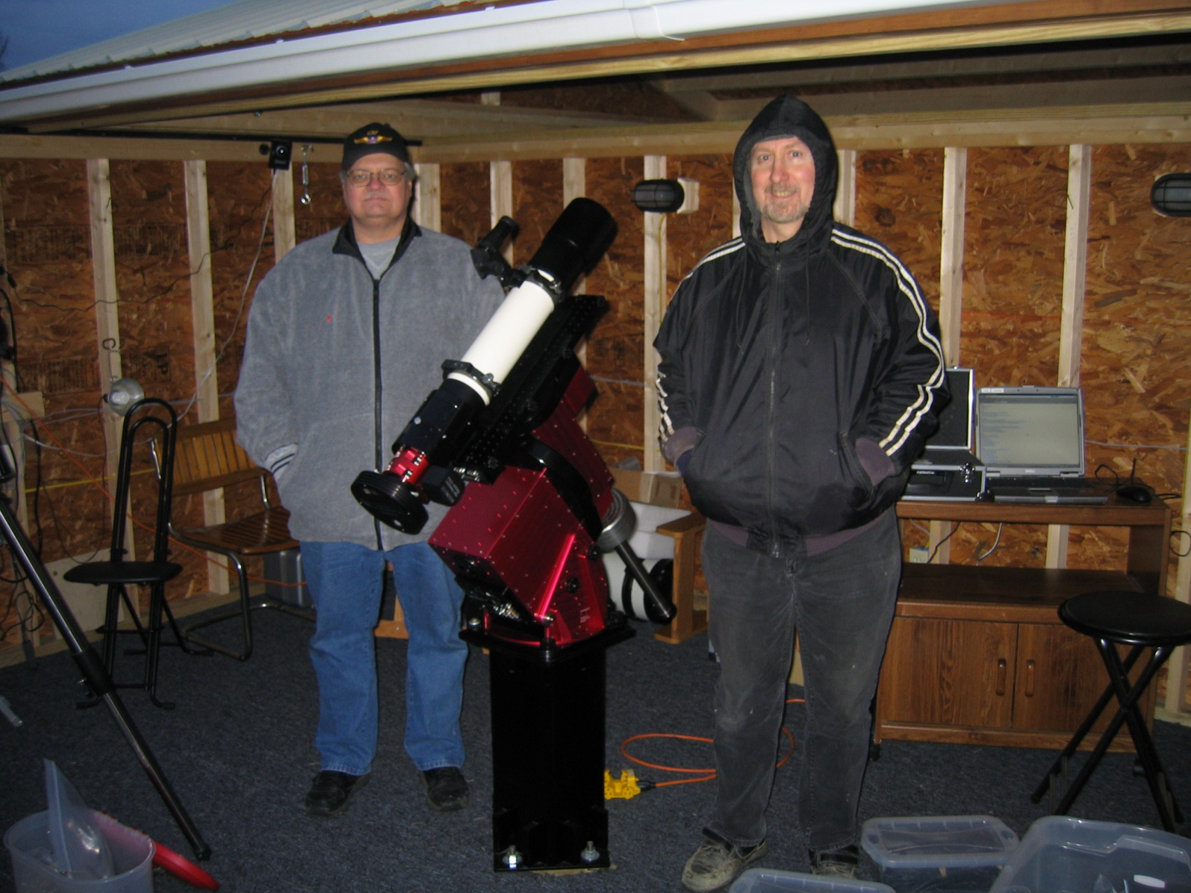
Initial Installation at BMVO, Jan 2010
Thanks to Don D’Egidio and Frank Colosimo

Slide 4
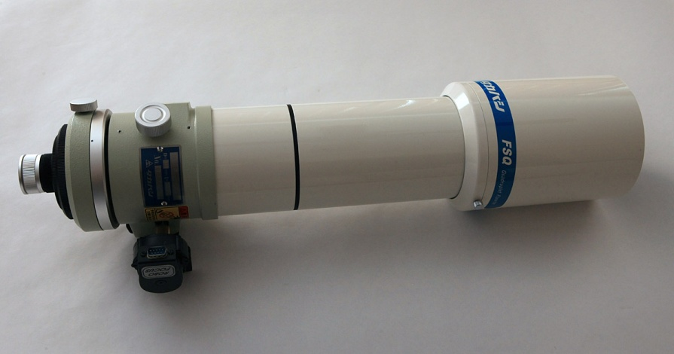
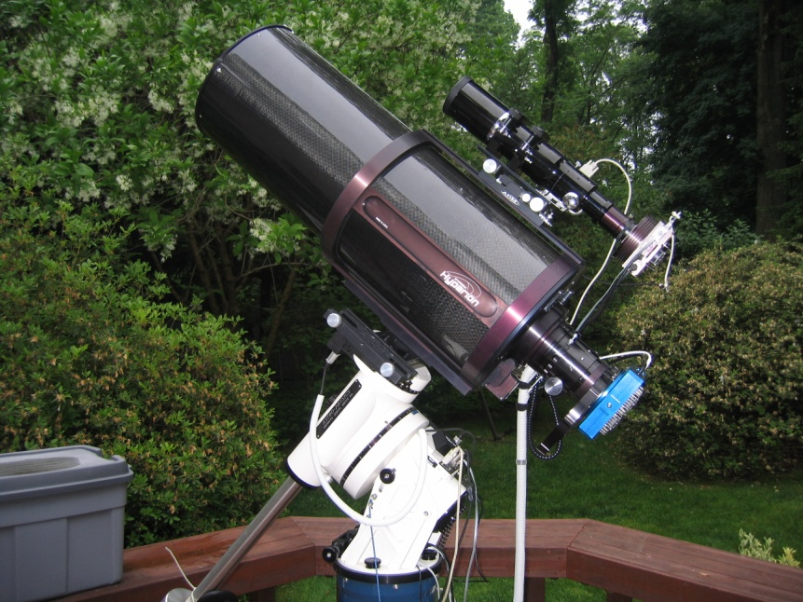
The Telescopes
  Takahashi FSQ-106N quadruplet fluorite APO refractor 106mm f/5
  88mm image circle
  Fully corrected FOV 9.5°
Starizona Hyperion 317mm f/8
Cassegrain reflector with Harmer-Wynne corrector
70 mm (1.6°) diffraction-limited image circle

Slide 5
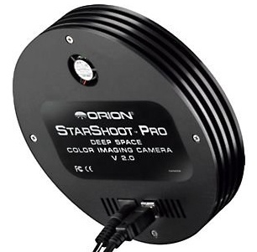
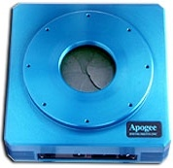
The Cameras
Color – Orion StarShoot Pro v1
(used with NP101 and TAK FSQ106)
Monochrome – Apogee U16M
(used with 12.5” Hyperion)

Slide 6
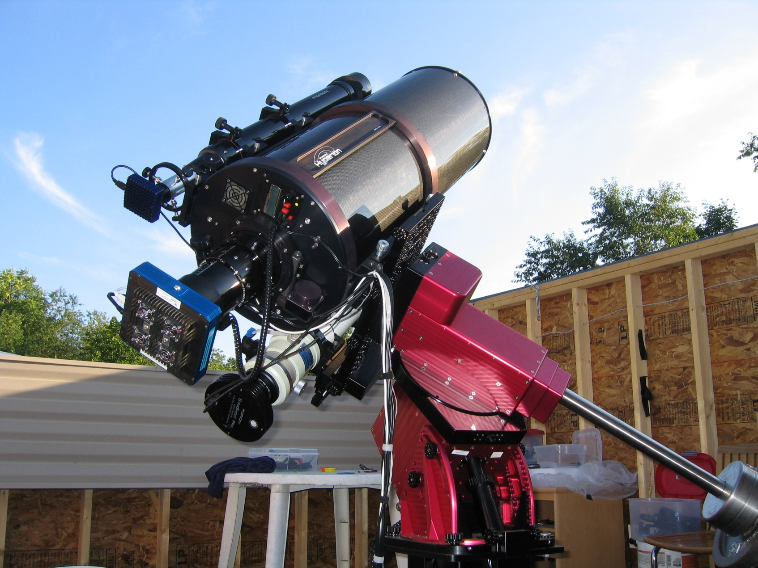
3 scopes, 3 cameras 1 mount on Paramount ME at BMVO, New Ringgold, PA - July 2010

Slide 7
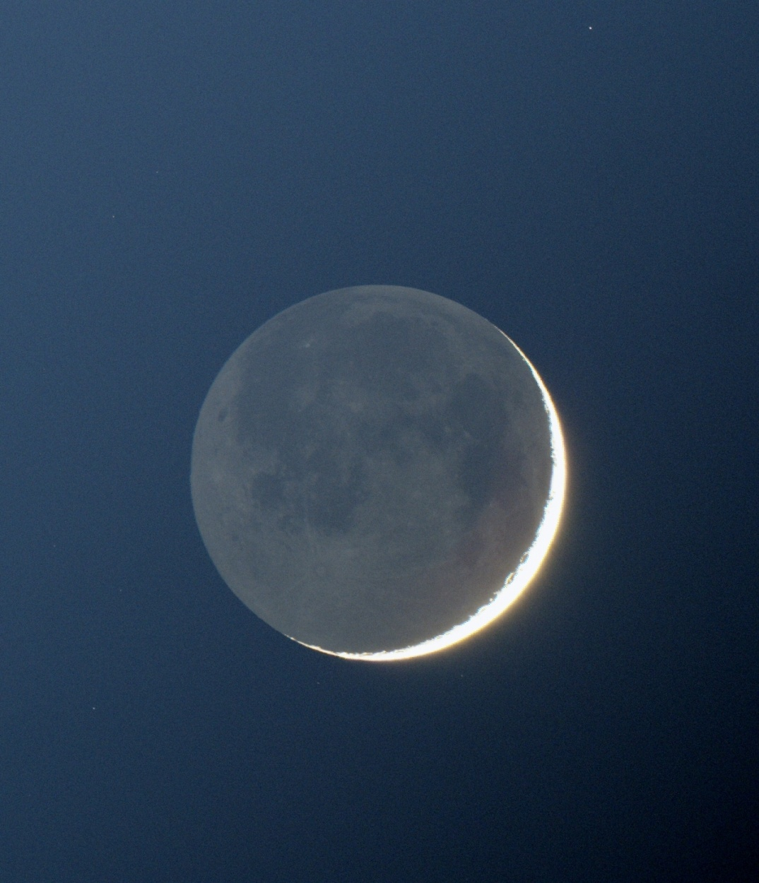
Two-day old Moon

Slide 8
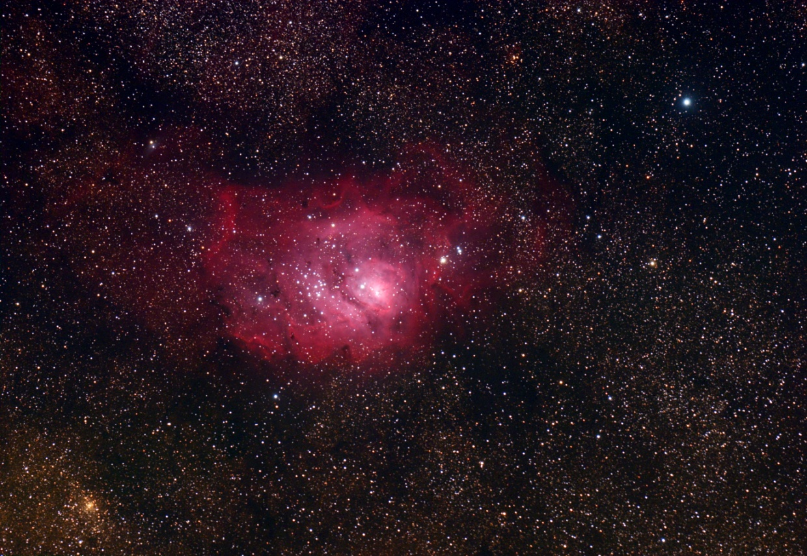
M8, the Lagoon Nebula in Sagittarius

Slide 9
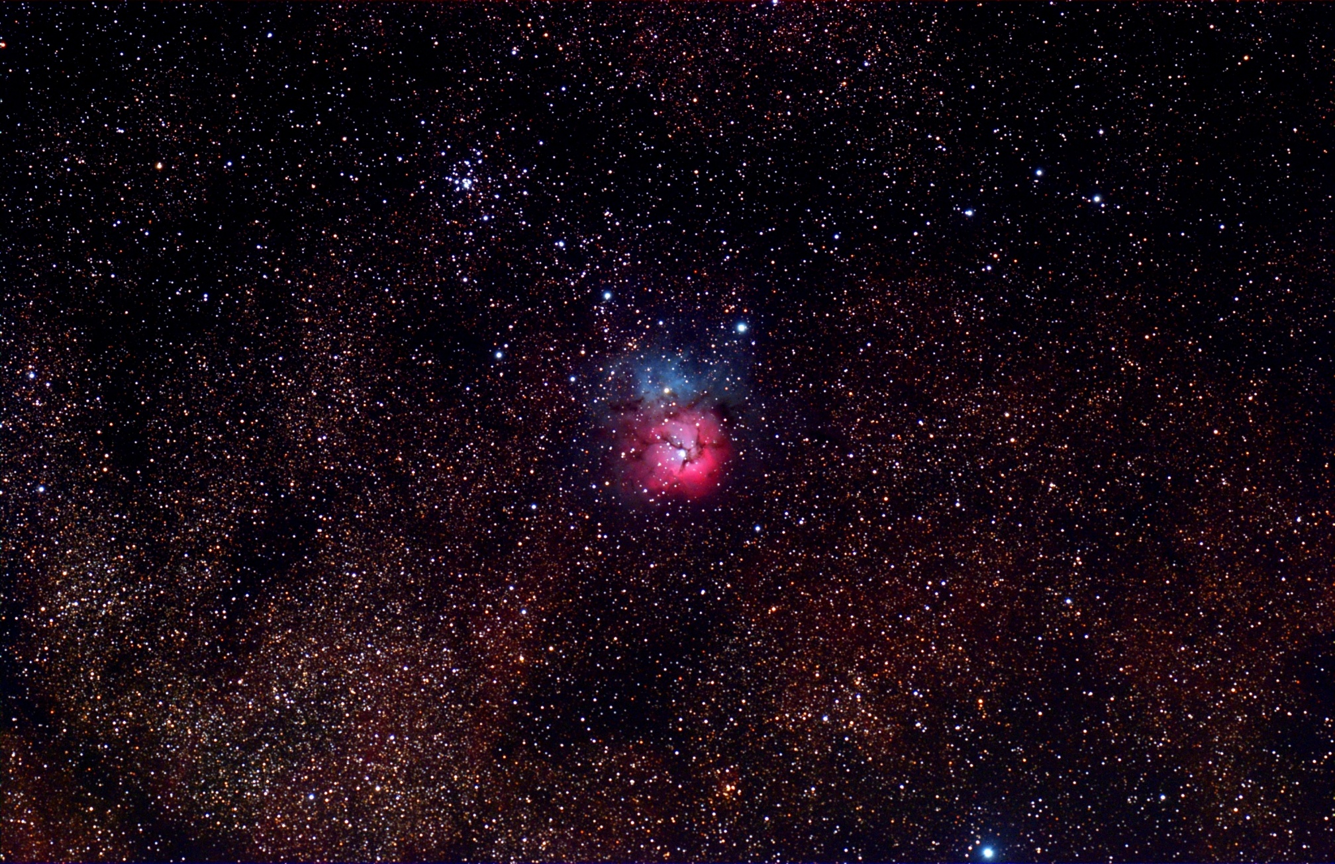
M20, the Trifid Nebula in Sagittarius
Notes:
30x2min, cropped

Slide 10
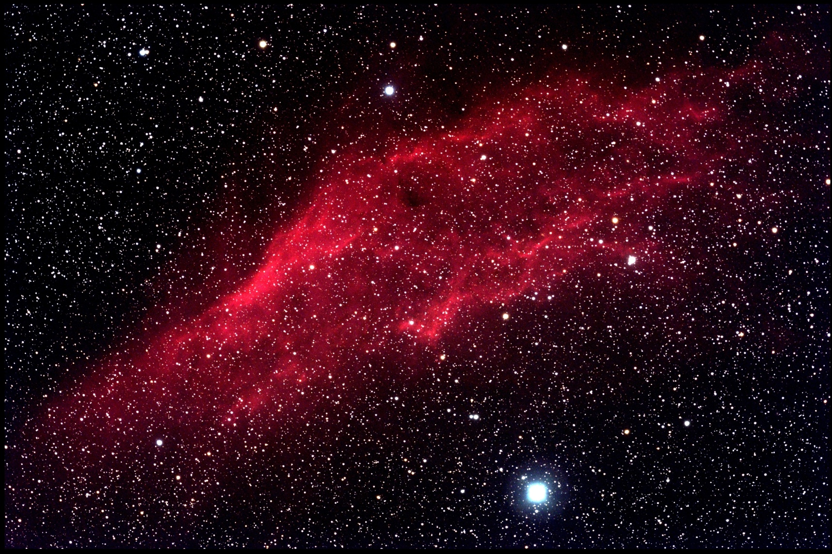
The California Nebula in Perseus, NGC1499

Slide 11
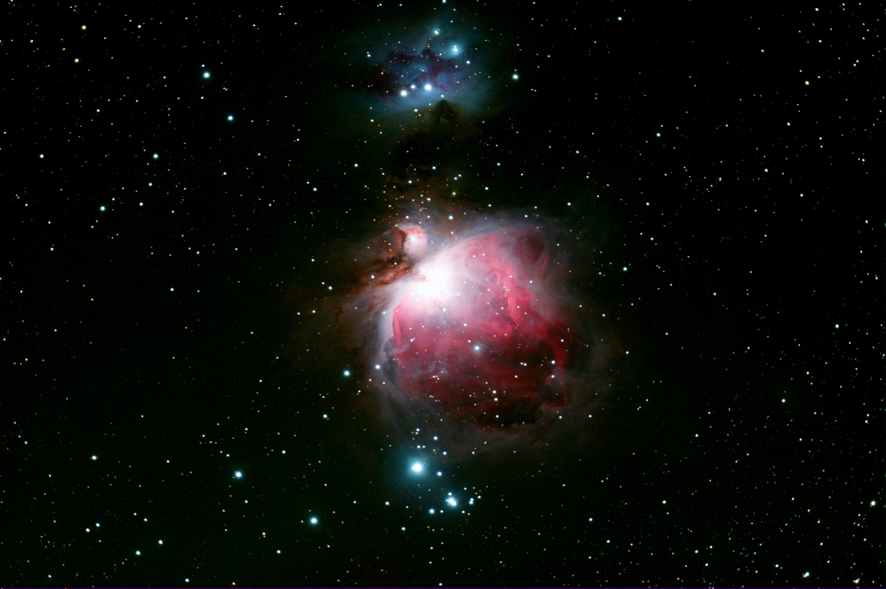
M42, the Orion Nebula
2010-02-12T23:53:07 16x5’ np101 f/5.4
Notes:
2010-02-12T23:53:07 16x5’ np101 f5.4

Slide 12
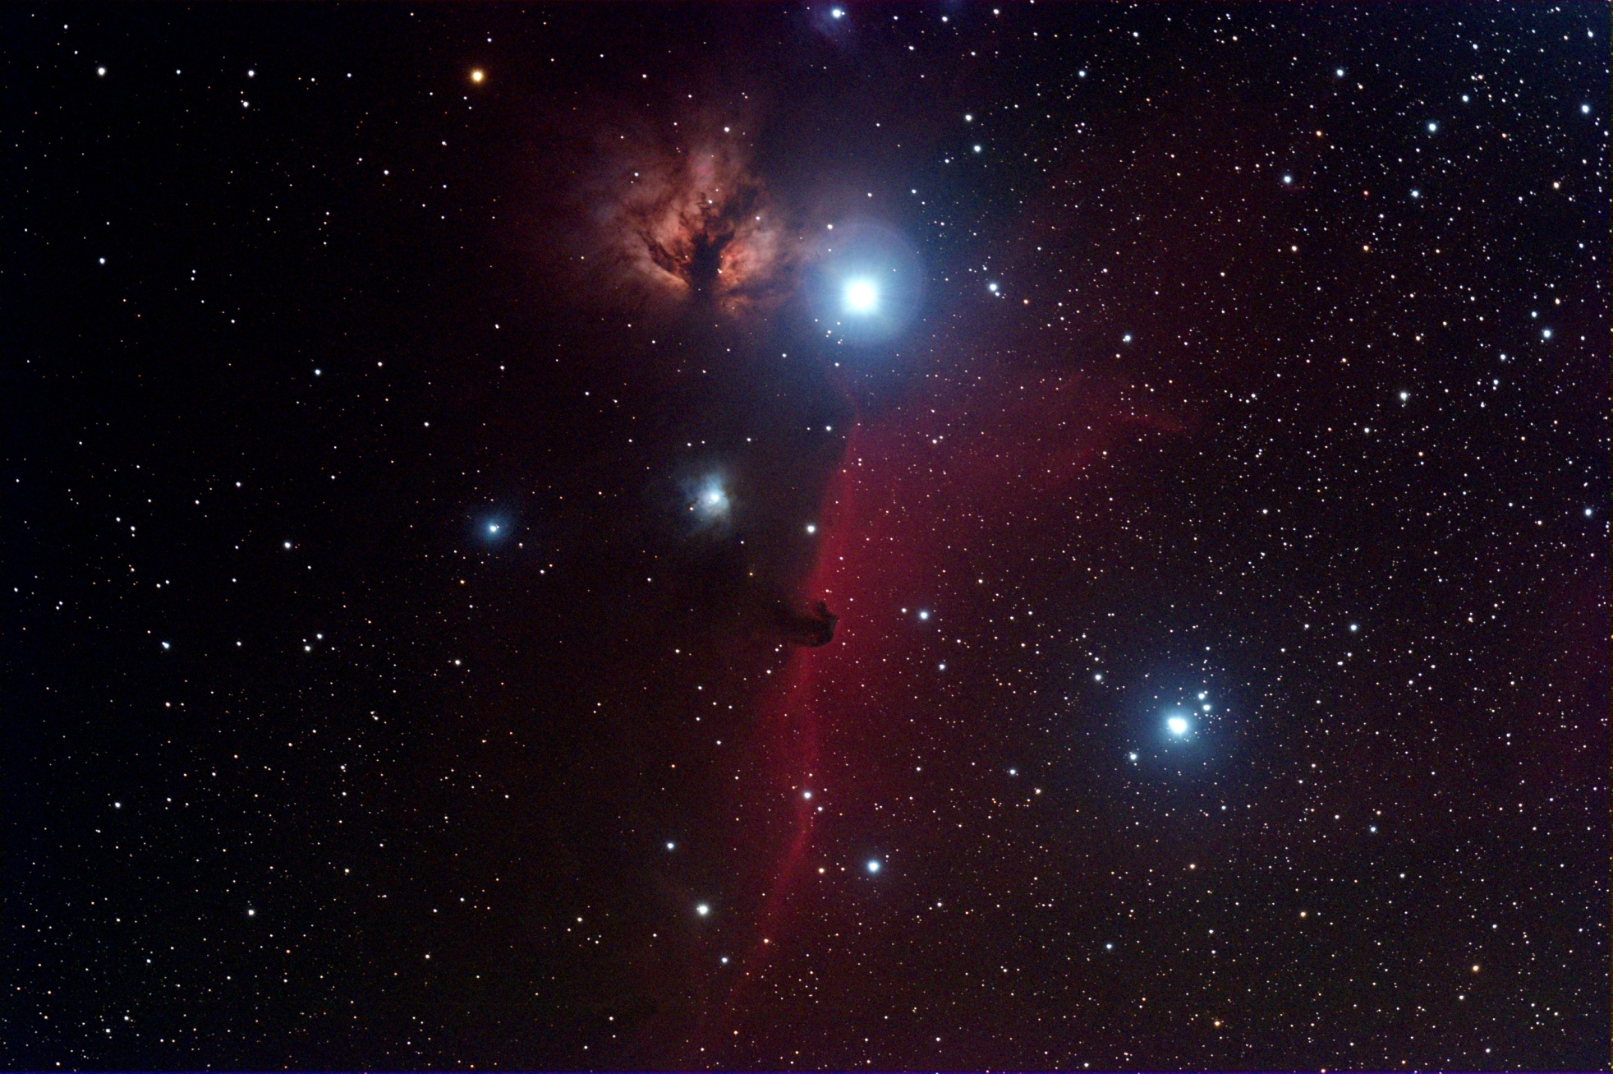
The Horsehead Nebula in Orion
(B33, a part of IC434)

Slide 13
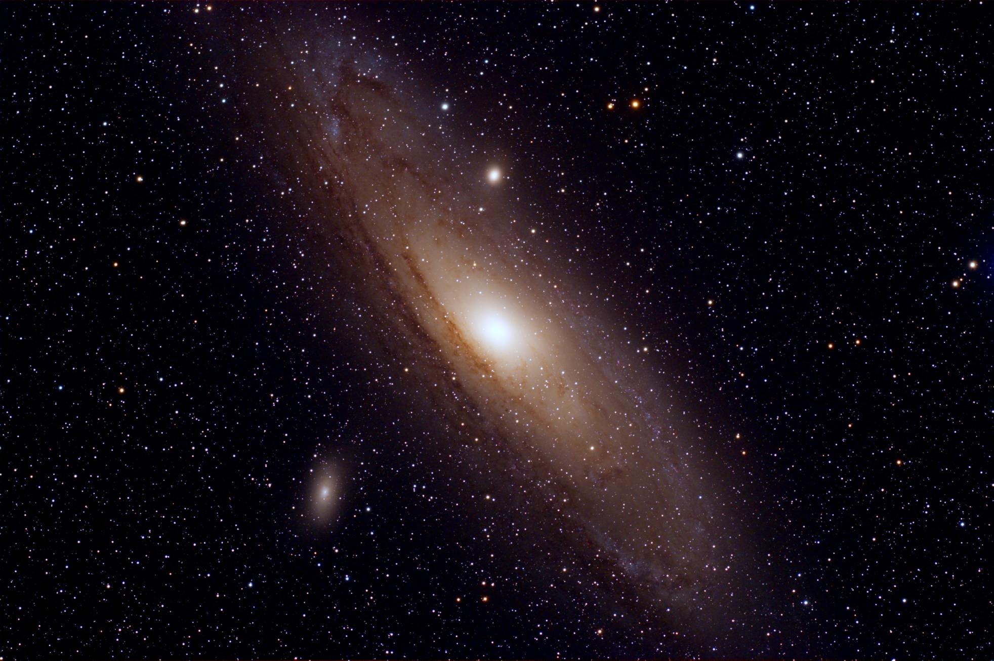
M31, the Andromeda Galaxy
distance ~ 2.5 Mly, z~.0002, RV~54 km/s

Slide 14
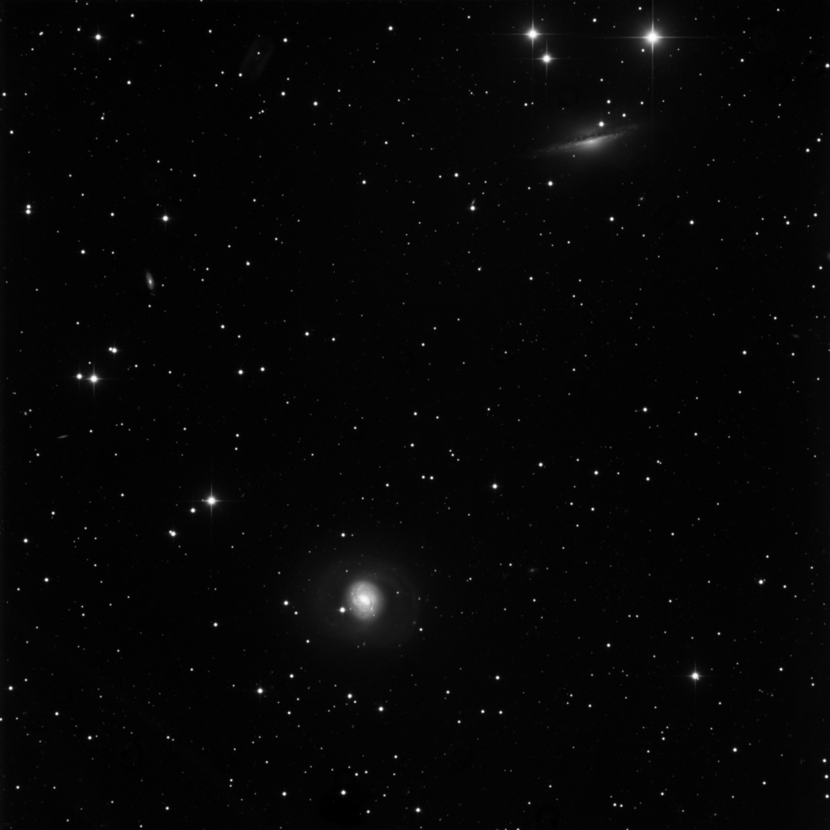
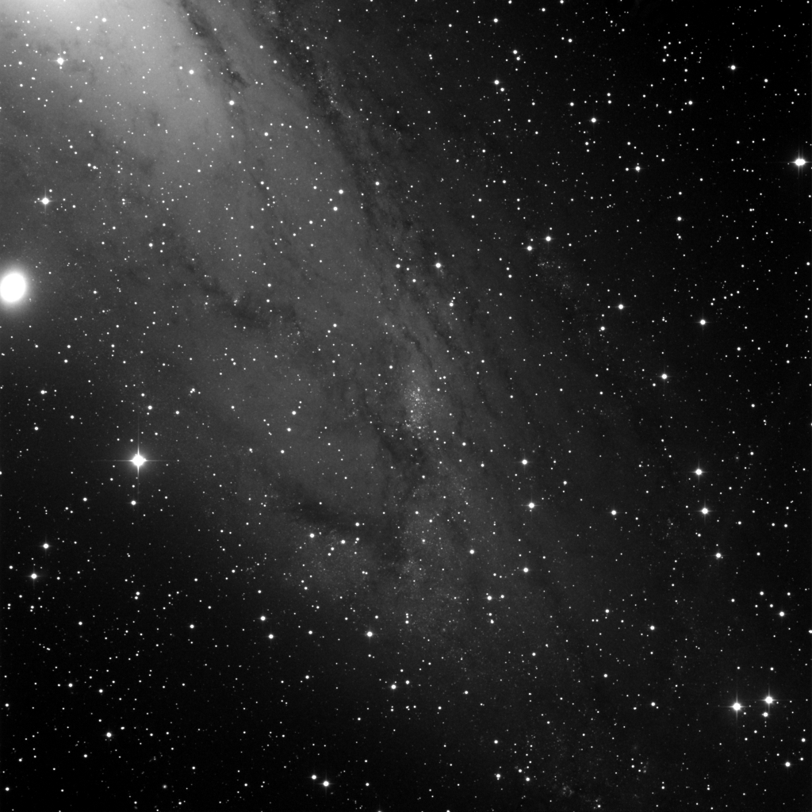
Deep Sky Images w Hyperion
Open cluster
in the Great Andromeda
galaxy
ngc206-12x5min-ddp.jpg
Notes:
Open cluster in the
Great Andromeda
galaxy

Slide 15
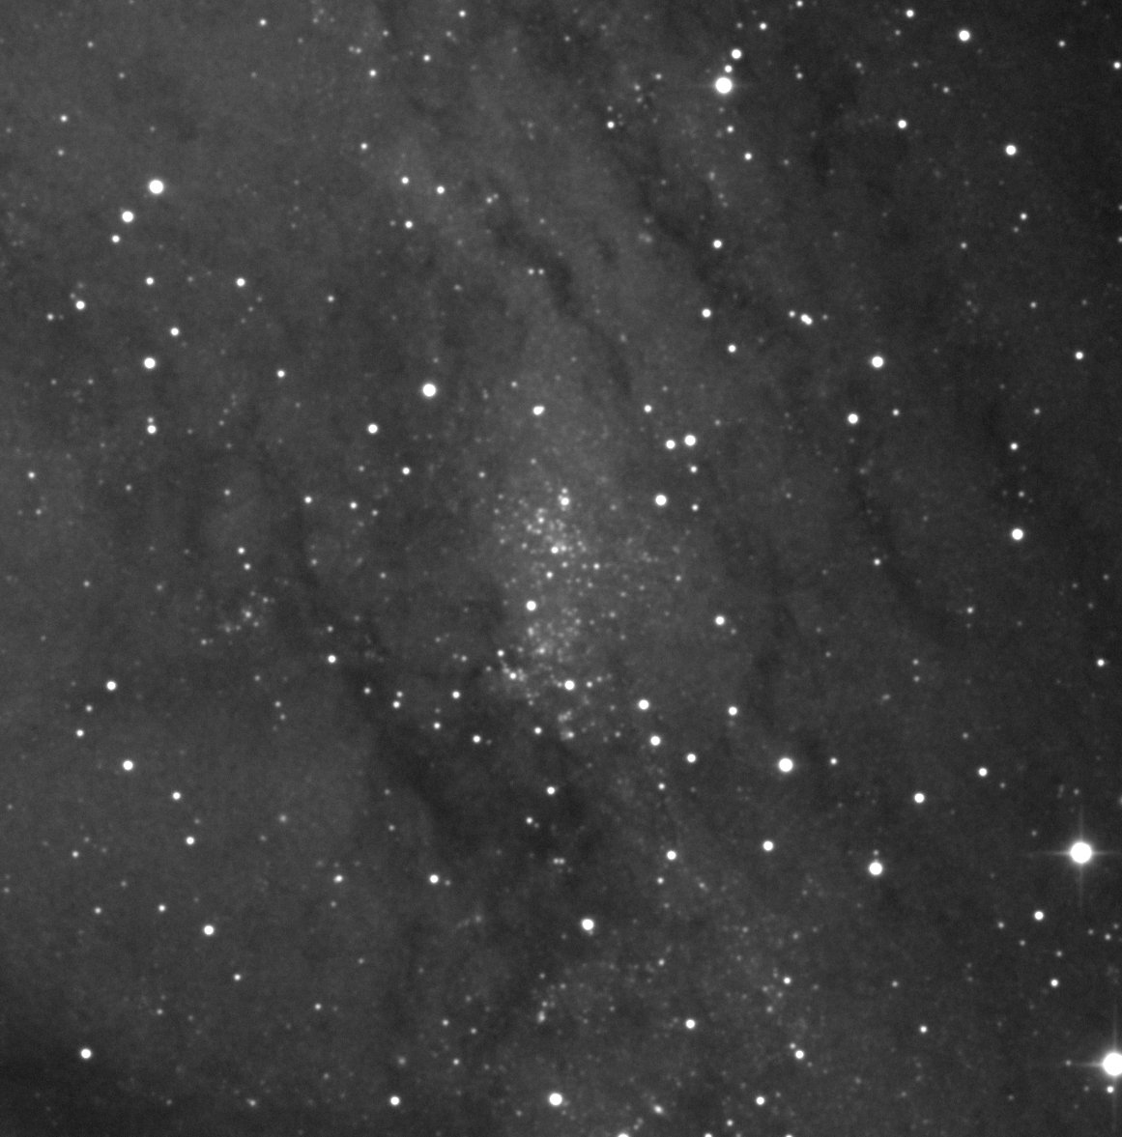
Deep Sky Images w Hyperion
Open cluster
in the Great Andromeda
galaxy
ngc206-12x5min-ddp.jpg
Notes:
Open cluster in the
Great Andromeda
galaxy

Slide 16
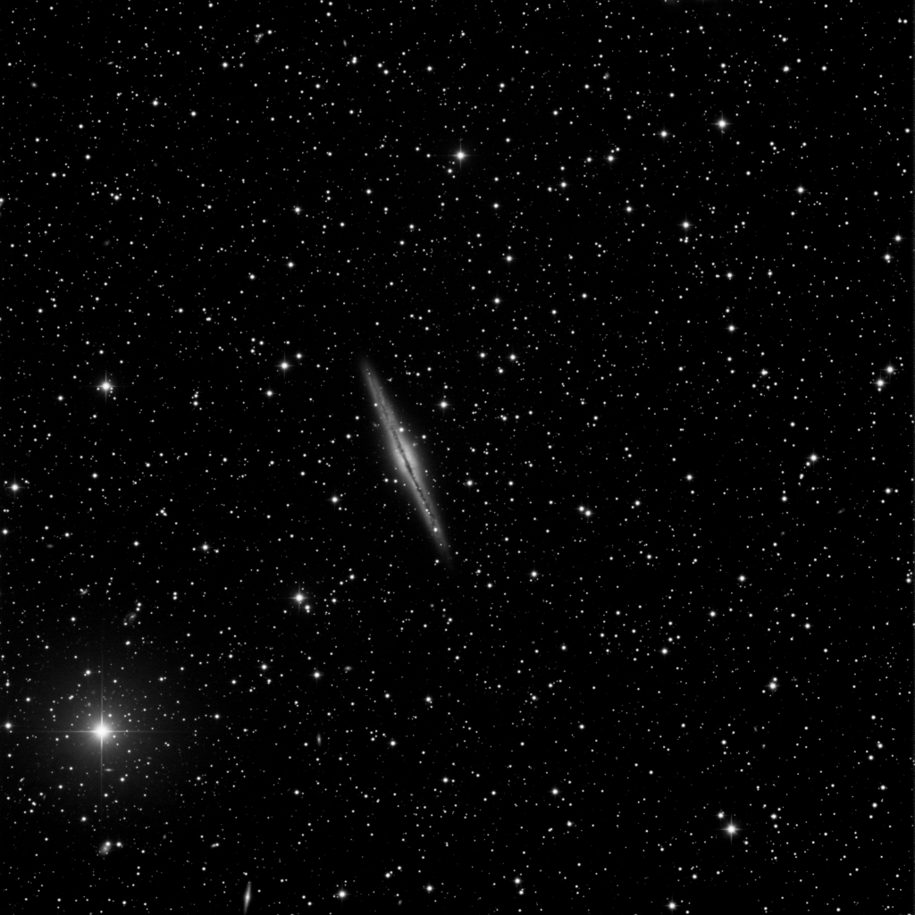
Deep Sky Images w Hyperion
The other Andromeda galaxy
ngc891-24x5min-ddp.jpg
Notes:
The other Andromeda galaxy

Slide 17
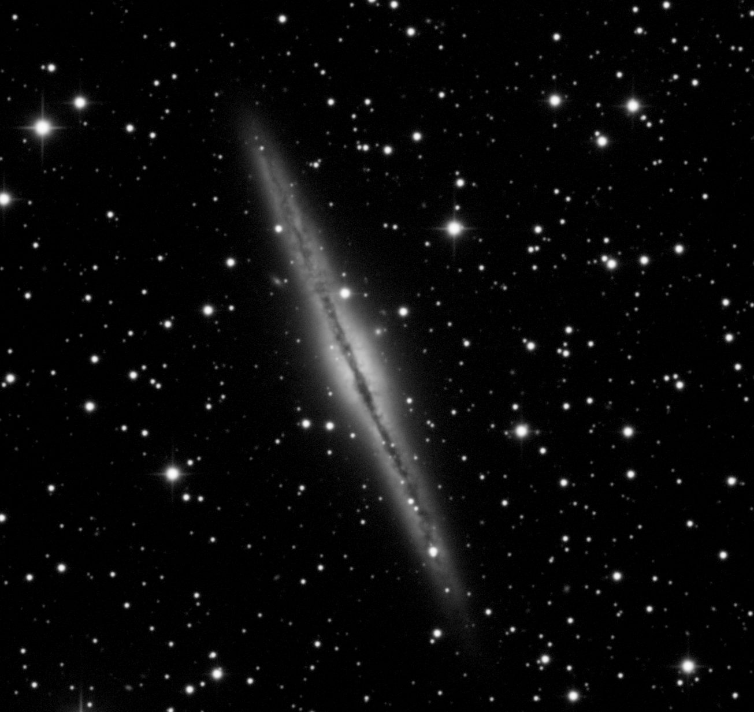
Deep Sky Images w Hyperion
The other Andromeda galaxy
ngc891-24x5min-ddp.jpg
Notes:
The other Andromeda galaxy

Slide 18
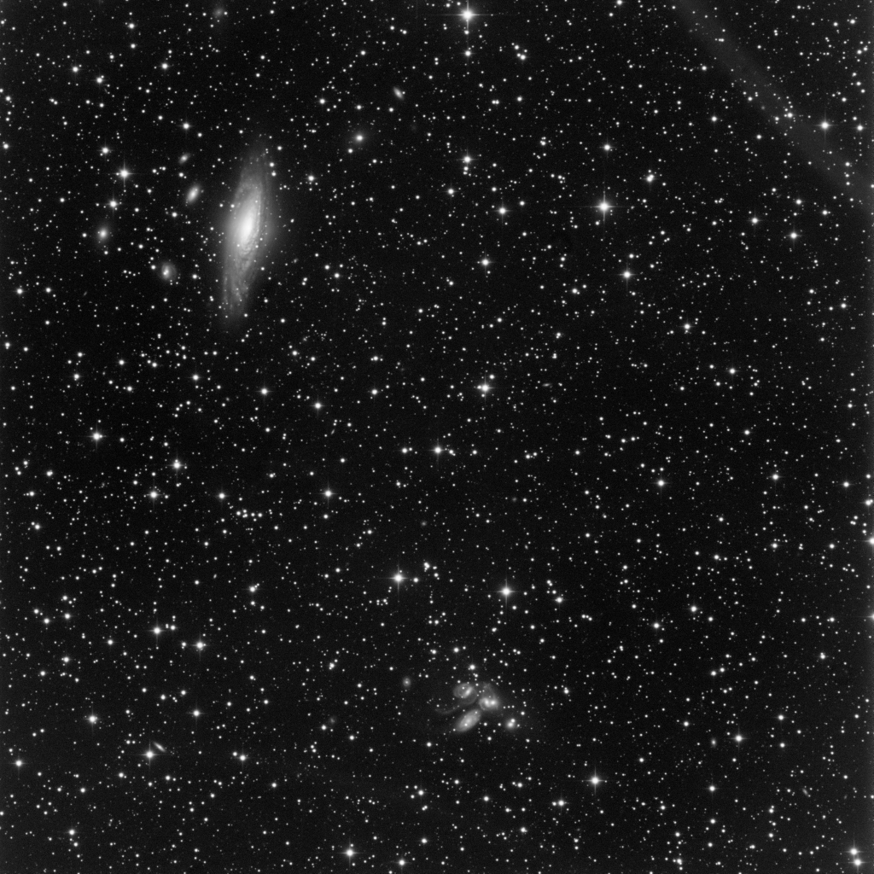
Deep Sky Images w Hyperion
ngc7331 + Stefan’s quintet
ngc7320-17x5min-ddp.jpg
Notes:
ngc7331 + Stefan’s quintet

Slide 19
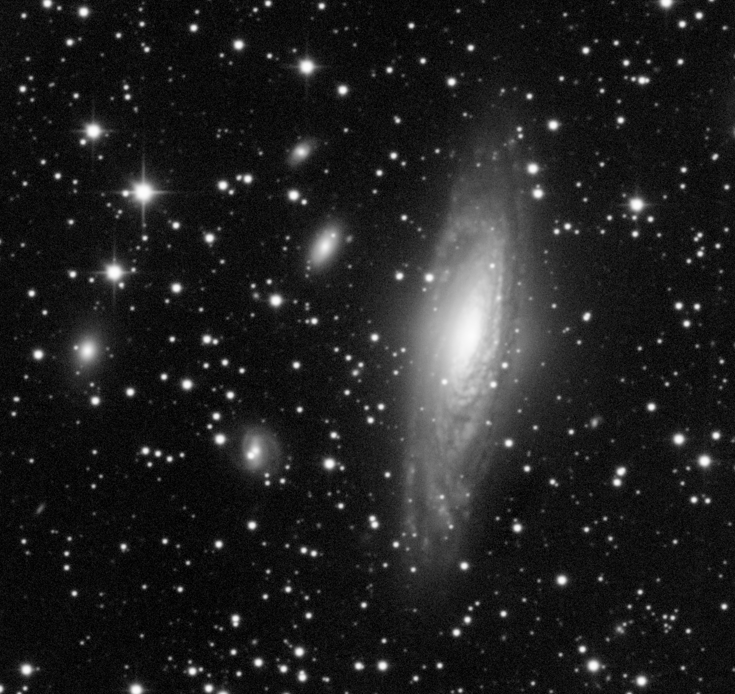
Deep Sky Images w Hyperion
ngc7331
ngc7320-17x5min-ddp.jpg
Notes:
ngc7331 + Stefan’s quintet

Slide 20
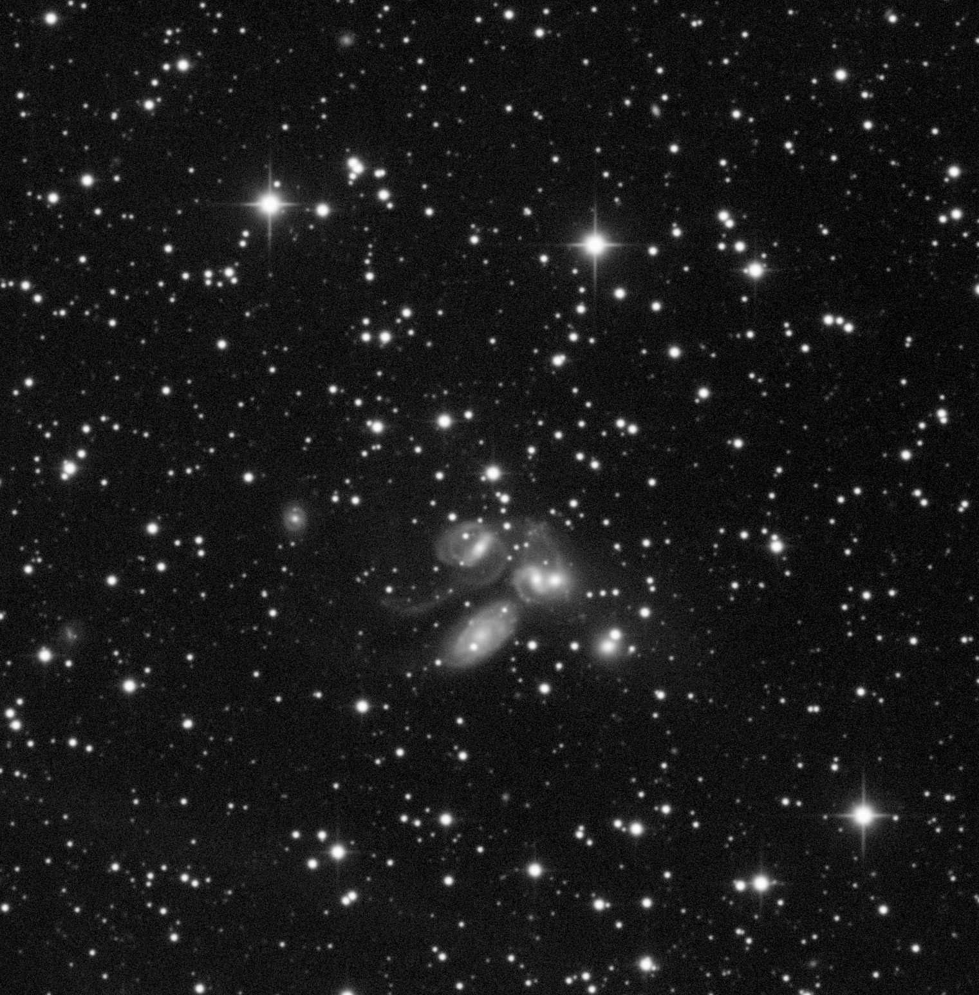
Deep Sky Images w Hyperion
Stefan’s quintet
ngc7320-17x5min-ddp.jpg
Notes:
ngc7331 + Stefan’s quintet

Slide 21
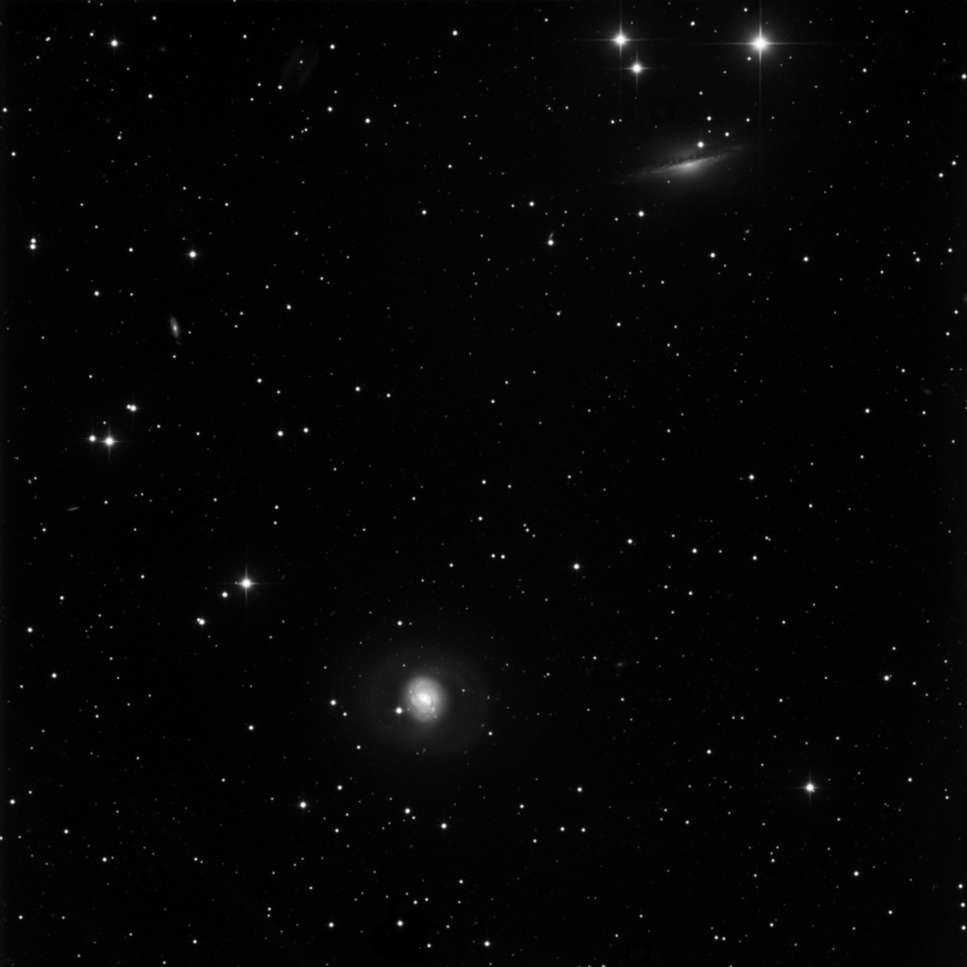
Deep Sky Images w Hyperion
Cetus A and
Sombrero-like
companion
m77+ngc1055-(11+11)x5min.ddp.jpg
Notes:
Cetus A galaxy &
Sombrero-like
companion

Slide 22
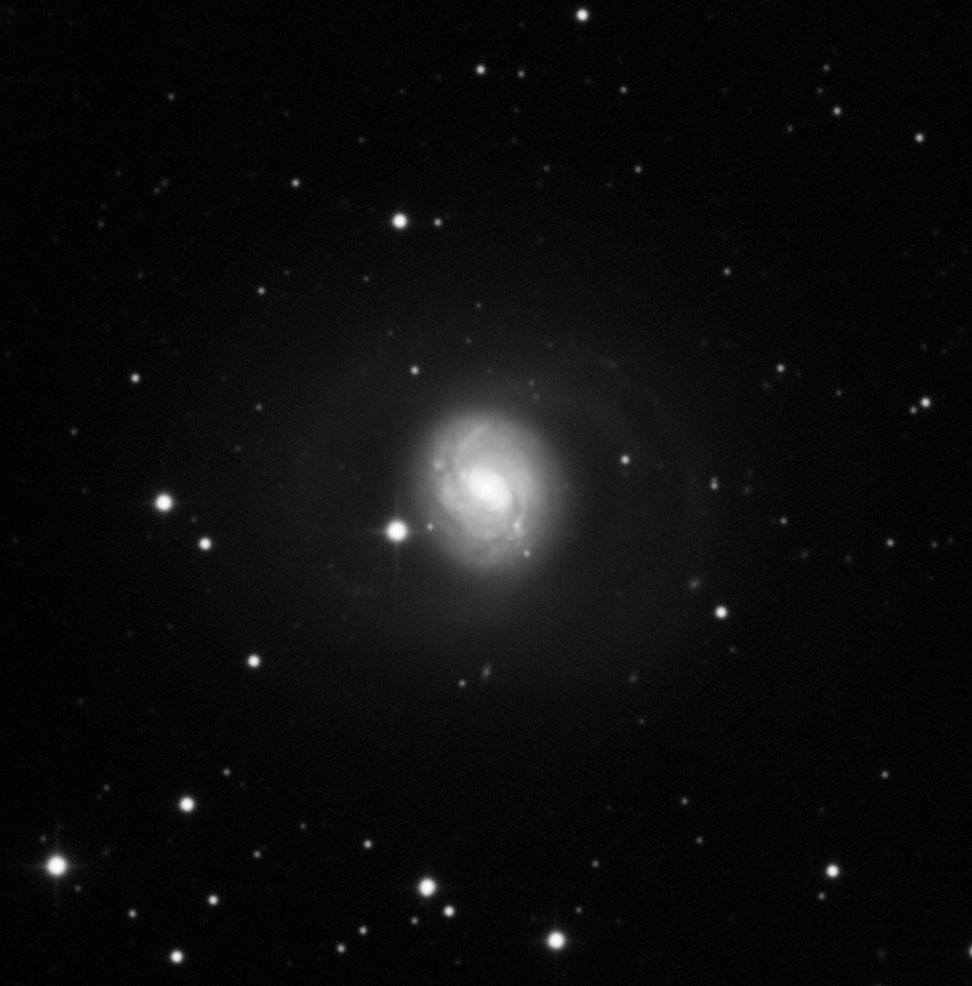
Deep Sky Images w Hyperion
M77,
Cetus A
m77+ngc1055-(11+11)x5min.ddp.jpg
Notes:
Cetus A galaxy &
Sombrero-like
companion

Slide 23
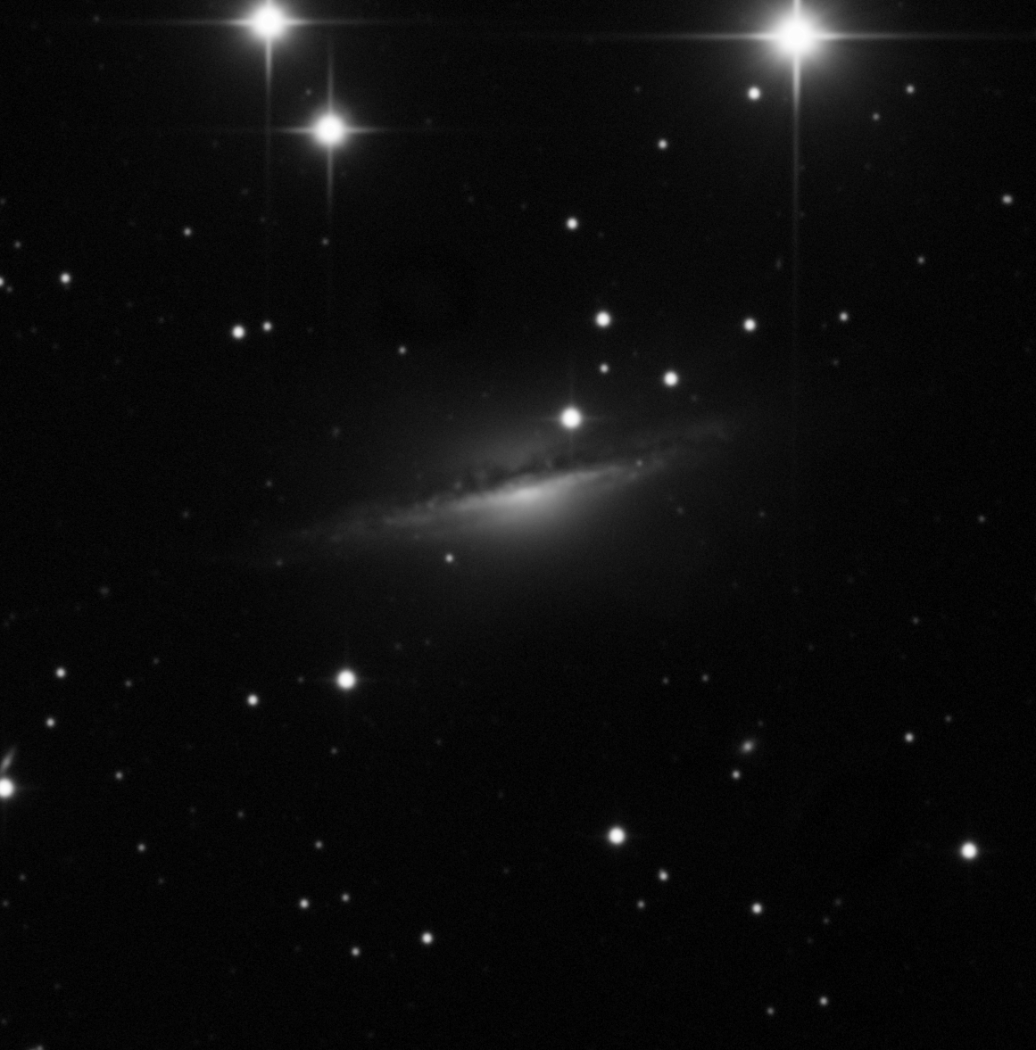
Deep Sky Images w Hyperion
ngc1055 (Sombrero-like
Galaxy)
m77+ngc1055-(11+11)x5min.ddp.jpg
Notes:
Cetus A galaxy &
Sombrero-like
companion

